Slide 1
Food Sovereignty in a Globalized Food System
Policy, Power, and Agroecology for Just Transitions
15–16 October 2025
Notes:
“Welcome to our intensive on Food Sovereignty in a Globalized Food System.
Over two days and 14 hours, we will
clarify concepts and stakes,
critically examine the global agro-industrial model,
analyze power, race, gender and justice,
explore agroecology and alternatives, and
practice with cases and debates.
You’ll leave with a diagnostic tool and a sovereignty strategy tailored to a local context.
We’ll also use Mentimeter throughout for quick polls, rankings, quizzes, and live Q&A.”

Slide 2
Please join our Mentimeter space now—scan the QR or enter the code. We’ll use it throughout for polls, rankings, and Q&A
1/4
Notes:
Mentimeter cue (1–2 min): display QR/code for the session; quick check: “Where are you joining from?” (open text, 1 word). Let’s use it to break the ice and test access. Slide 2-3-4

Slide 3

Notes:
SLIDE MENTIMETER 13 – 14 – 15 – 16 - 17

Slide 4
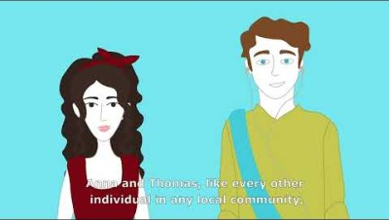

Slide 5
Course Objectives
By the end of this intensive, participants will be able to:
Understand the foundations of food sovereignty and distinguish it from food security and self-sufficiency.
Diagnose global food-system imbalances (value chains, trade dependence, corporate concentration, crisis vulnerability, and access inequalities).
Analyze the role of public policies and institutions (national/EU/international) and their contradictions for local agriculture.
Explore and assess sustainable alternatives (agroecology principles, short supply chains, cooperatives, and civic innovations) and the conditions for scaling.
Design territorial food-autonomy strategies (stakeholder mapping, local levers, governance, and an action plan).
Work on a development project using a logical framework, including ethics, financing, indicators, and risk identification and mitigation.
Notes:
Setting our destination (15–16 Oct 2025)
We have two days and five modules. I’ll show where we’re going, why it matters, and how each step connects to practice.
Foundations & distinctions
Food sovereignty asks who decides about food systems.
It’s not the same as food security (do we have enough food?) or self-sufficiency (do we produce it at home?).
I’ll lean on Patel (2007) for power in supply chains and Shiva (2015) for biodiversity and seed/knowledge commons.
Diagnosing global imbalances
We’ll scan value chains, trade dependence, corporate concentration, crisis exposure, and access inequalities.
Galvez (2018) links trade rules to changing diets; Patel (2007) unpacks market power; Abis (2024) brings in logistics and geopolitics.
Policies & institutions
We’ll look at national, EU, and international arenas—think CAP, trade, and aid.
The core tension is liberalization versus support for local farming.
Attac (2009) helps map EU levers; Moseley (2022) shows how to decolonize policy paths.
Alternatives and how to scale them
We’ll explore agroecology, short supply chains, cooperatives, AMAP/CSA, and civic innovations.
We’ll also name the limits and the conditions for scaling: land access, finance, logistics, and governance.
Shiva (2015) and Moseley (2022) ground the principles; Canfield (2022) guides how ideas enter institutions.
Territorial strategies
You’ll run a quick diagnostic—vulnerability and dependence using simple IDR/HHI checks.
Then we’ll map stakeholders, pick local levers (procurement, land/tenure, relocalization), and sketch governance plus an action plan.
Reese (2019) keeps us focused on justice—race, gender, and class.
Project implementation (logical framework)
We’ll set the problem, objectives, and outputs/outcomes, choose partners, and plan financing and ethics.
You’ll define clear KPIs and list risks with mitigation measures.
Close and bridge
These objectives guide our activities and quick quizzes.
Now, let’s start with the core definitions and a short baseline poll to see where we stand.

Slide 6
What is “Food Sovereignty”?
• La Vía Campesina (Nyéléni, 2007): “Food sovereignty is the right of peoples to healthy and culturally appropriate food - produced through ecologically sound and sustainable methods, and the right to define their own food and agriculture systems.”
• FAO/UN usage: FAO recognizes food sovereignty as a holistic, justice-oriented approach that goes beyond food security, emphasizing that “control over food systems” should remain with food producers and communities.
Notes:
Two key framings of food sovereignty: one as a right, one as an approach.
La Vía Campesina
“Food sovereignty is the right of peoples…”
Focus on claim-holders (peoples/communities)
Content of the right: healthy, culturally appropriate, ecologically sound food.
Plus the right to define food and agriculture systems.
Key words to say aloud: right, peoples, define their systems.
FAO/UN usage (APPROACH)
Treated as a holistic, justice-oriented approach that goes beyond food security.
Emphasizes control over food systems by producers and communities.
Used as a policy/program lens rather than a legal claim.
Key words: approach, justice, control, communities.

Slide 7
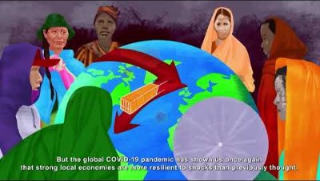

Slide 8
What is “Food Sovereignty”? — Governmental References (France & Italy)
• France (legal definition, 2025): French law frames “food sovereignty” as maintaining and developing the Nation’s capacity to produce, process, and distribute agricultural and food products needed for everyone’s access to healthy food, while supporting export capacities contributing to global food security.
• Italy (policy usage, since 2022): The Ministry’s name includes “Food Sovereignty” (MASAF). National decrees operationalize a “Food Sovereignty Fund” (2023–2025) to support strategic supply chains and financing—there is no single statutory definition of the concept, but a policy focus on national agri-food capacity.
Notes:
France (law, 2025): A legal definition: safeguard and develop national capacity to produce, process, and distribute healthy food for all—while supporting exports that contribute to global food security.
Italy (policy use, since 2022): “Food Sovereignty” in MASAF title; a Food Sovereignty Fund (2023–2025) backs strategic supply chains and finance; no single statutory definition, but a policy focus on national agri-food capacity.
Bottom line: France = clear legal frame. Italy = policy instruments, no unified legal definition.

Slide 9
What is “Food Sovereignty”?
Vandana Shiva
“Who really feeds the world? Not industrial agribusiness but biodiversity, small-scale farmers, seed freedom, and localization.” Food sovereignty centers living soils, farmer agency, and the commons (seeds/knowledge).
Raj Patel
Food sovereignty means democratic control over food systems—challenging corporate concentration and policies that create “the stuffed and the starved.” It reframes hunger as a power problem, not a production shortfall.
Jan Douwe van der Ploeg
A peasant-centered vision: sovereignty emerges from the autonomy of peasant agricultures and their ongoing struggles with “food empires”; rebuilding room for manoeuvre in territories and value chains.
Notes:
Vandana Shiva: Not agribusiness but biodiversity, small-scale farmers, seed freedom, localization.
Centers living soils, farmer agency, and the commons (seeds/knowledge).
Raj Patel: Democratic control over food systems; confront corporate concentration. Hunger is a power problem, not a production shortfall—“the stuffed and the starved.”
Jan Douwe van der Ploeg: Peasant-centered sovereignty from autonomy and ongoing struggles with “food empires.” Rebuild room for manoeuvre in territories and value chains.
Shiva = ecology & commons; Patel = power & democracy; van der Ploeg = peasant autonomy & territorial space.

Slide 10
Don’t Confuse “Food Sovereignty” (Nyéléni) with Nationalist “Sovereigntism”
Food Sovereignty (Nyéléni, 2007 — movements)
  People’s right to define their food and agriculture systems
  Ecological production; culturally appropriate diets; community & producer agency
  Emphasis on justice, participation, and commons (seeds/knowledge)
  Works through solidarity across local–global scales
Nationalist “Sovereigntism” (state-centric rebranding)
  Narrows to national self-sufficiency/competitiveness and identity politics
  Frames “sovereignty” as state control & market shielding, often decoupled from justice/ecology
  Policy signals: symbolic bans, “tradition protection,” export push labeled as “sovereignty”
  Risks: co-optation of movement language, protectionist drift, exclusion, erosion of rights & participation
Why this distinction matters
  Nyéléni centers who decides and how (democracy & rights), not only how much is produced
  Nationalist uses can invert the concept—turning a justice agenda into economic/cultural nationalism

Slide 11
Food Sovereignty vs. Food Security
Food sovereignty: The right of peoples to define their own food systems. It centers who decides—democratic control, culturally appropriate diets, and ecologically sound production.
Food security: A condition where all people, at all times, have access to sufficient, safe, nutritious food. It focuses on outcomes—availability, access, utilization, and stability.

Slide 12
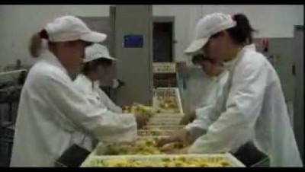
https://www.youtube.com/watch?v=3e_AgqOsRNE
Notes:
"Our Daily Bread" is a sensationalist film about the food industry. Produced by Australian filmmaker Nikolaus Geyrhalter,

Slide 13

Module 1. Why Did “Food Sovereignty” Emerge?
• A political response to the asymmetries of food-system globalization
• Liberalized trade + global value chains → concentrated market power
• Externalities made visible: UPF diets, biodiversity loss, farm vulnerability
• 2007–08 food price crisis exposed import/export dependence
• FS => From “how much food?” to “who decides and on what terms?”
5
Notes:
“This module asks why the idea of food sovereignty appears when it does.
It emerges as a political response to the way globalization has reorganized food:
liberalized trade and global value chains have concentrated power from seeds to retail.
The externalities became hard to ignore—ultra-processed foods shaping diets, biodiversity loss, and precarious livelihoods.
The 2007–08 food price crisis was a turning point, revealing import–export dependencies and volatility.
Food sovereignty shifts the question from ‘how much food do we produce?’ to ‘who decides and under what rules?’
nota
We will unpack these drivers next.”
Mentimeter silde 5

Slide 14
Why Did “Food Sovereignty” Emerge? - Late-20th Century Triggers
• Trade liberalization (WTO/NAFTA) restructured agri-food markets
• Global value chains → price-setting power shifted upstream/downstream
• Corporate consolidation in seeds/inputs, trading, and retail
• Financialization of commodities → volatility and speculation
• Diet transitions: rise of ultra-processed foods (UPFs) and branded retail
• Environmental costs externalized: soil degradation, water stress, biodiversity loss
• Smallholder squeeze: input dependency, higher depts, land pressure
Notes:
1. In the late 20th century,
trade agreements like WTO rounds and NAFTA rewired agri-food markets.
2 As value chains globalized, price-setting power moved away from farmers toward input suppliers, traders, and retailers.
3 Consolidation accelerated—few firms dominated seeds, chemicals, grain trading, and supermarket.
4 At the same time, food became a financial asset, increasing price volatility.
5 These shifts coincided with rapid diet transitions—the expansion of ultra-processed foods and branded retail—
5 environmental costs were off-loaded to soils, water, and biodiversity.
The result was a squeeze on smallholders: dependency on purchased inputs, higher debt, and pressure on land.
These triggers set the stage for a political response—food sovereignty
- Patel (2007) on concentration and power; Gálvez (2018) on trade and diet transitions; Abis (2024) on supply/logistics constraints; Shiva (2015) on ecological externalities.

Slide 15
Why Did “Food Sovereignty” Emerge? - 2007–08 Food Price Crisis: A Turning Point
•Prices spiked hard (rice, wheat, maize) → unrest in 40+ countries.
• Exposed import/export dependence and thin global buffers
• Policy : export bans, panic buying, biofuel mandates questioned
• Urban poor hit hardest; smallholders faced volatile input/market prices
• Put sovereignty on the agenda: resilience, local control, public procurement
Notes:
The 2007–08 crisis was a watershed.
Prices for rice, wheat, and maize jumped rapidly, triggering protests and policy shocks in dozens of countries.
The crisis exposed how dependent many places had become on imports and on thin, concentrated supply chains.
POLICY: Governments scrambled—some imposed export bans, buyers panic-purchased, and biofuel policies came under scrutiny.
The urban poor bore immediate food-access pain, while smallholders confronted volatile input and output prices.
In this moment, food sovereignty gained traction as an agenda focused on resilience—shorter chains, local control over key staples, and tools like public procurement to stabilize demand and support producers.
This is the backdrop for the movement principles we examine next.

Slide 16

Food Sovereignty — Quick History & Vision
1996: La Vía Campesina launches the idea. Goal: resist corporate-led food systems; support local economies; fight hunger and poverty.
The idea spreads worldwide—to movements, governments, and some multilateral bodies.
2001 (Havana): Farmers, fishers, Indigenous peoples, civil society, and scholars meet to set conditions for food sovereignty.
Activists oppose the WTO farm deal and call for public support to family, sustainable farming.
2007 (Mali): 500+ delegates from 80 countries build strategies. The Nyéléni Declaration sums up the movement’s vision.
2015 (Nyéléni Agroecology Forum): Movements agree on a common definition of agroecology.
Core vision: New social relations without oppression or inequality (gender, race, class, generation, peoples).
Works for rural and urban, in rich and poor countries.
Purpose: Resist neoliberal, free-market harms; build democratic, fair, and sustainable food systems.
At the center: Small-scale food producers—peasants, fishers, pastoralists, Indigenous peoples, and rural workers.
Notes:
“Food sovereignty comes from grassroots movements: peasants, Indigenous peoples, fishers, and food workers since the 1990s.”
“The Nyéléni Declaration (2007) says: people have the right to define how their food and farming systems work.”
“Key ideas: ecological farming, culturally appropriate food, participation and rights, local control of land, water, and seeds, and solidarity between places.”
“It puts farmers and communities at the center and protects seed and knowledge commons—not just private, purchased inputs.”
“Success is not only about higher yields. It’s also about justice, resilience, and dignity.”
“As we move on, we’ll use these principles to judge policies and alternatives: do they increase community control and ecological health, or not?”

Slide 17
Why Did “Food Sovereignty” Emerge?
Movement Origins & Nyéléni Principles https://nyeleni.org/IMG/pdf/declarationfinalmars.pdf
• Roots in peasant, Indigenous, fisherfolk, and food-worker movements (1990s → today)
• Nyéléni Declaration (2007): right of peoples to define their food & agriculture systems
• Core principles: ecology, culturally appropriate food, participation & rights, local control, solidarity
• Centers producer & community agency; protects seed/knowledge commons
• Shifts metrics from yields alone → justice, resilience, and dignity
Notes:
“Food sovereignty comes from grassroots movements: peasants, Indigenous peoples, fishers, and food workers since the 1990s.”
“The Nyéléni Declaration (2007) says: people have the right to define how their food and farming systems work.”
“Key ideas: ecological farming, culturally appropriate food, participation and rights, local control of land, water, and seeds, and solidarity between places.”
“It puts farmers and communities at the center and protects seed and knowledge commons—not just private, purchased inputs.”
“Success is not only about higher yields. It’s also about justice, resilience, and dignity.”
“As we move on, we’ll use these principles to judge policies and alternatives: do they increase community control and ecological health, or not?”

Slide 18
Why Did “Food Sovereignty” Emerge? - Globalization’s “Double Bind”
Whatever you choose, there’s a cost. You’re “stuck between two bad options.”
1 Open markets bring new opportunities — but also new dependencies
2 Farms tied to imported inputs (seeds, fertilizers, feed) and global prices
3 Private standards (retailers/certifiers) can set the rules over states
4 “Efficiency” gains VS loss of decision power for producers and territories
5 Thin, long supply chains → volatility and low resilience in crises
6 Result: local actors carry risks, while value and control sit elsewhere
Notes:
1 Globalization brings new markets, but also new dependencies.
2 Many farms rely on imported seeds, fertilizers, and animal feed.
Big traders and retailers often set the rules and prices, not farmers.
3 Private standards (labels, buyer specs) can be stricter than public laws.
4 We gain some efficiency, but lose decision power at local level.
5 Long, complex supply chains work in good times, but break easily in crises.
6 When prices jump, local people carry the risk; profits and control sit elsewhere.
Key question for sovereignty: who decides what is grown, how, and for whom?
Transition line: next we ask who gains and who loses—power and justice.

Slide 19
Why Did “Food Sovereignty” Emerge? - Who Gains, Who Loses? Power & Justice
1 Market power: a few firms capture value; farmers and workers get thin margins
2 Unequal impacts by class, race, gender, and territory (urban peripheries, rural margins)
3 Access gaps: cheap UPFs vs. costly fresh foods; transport and time barriers
4 Land & tenure: concentration, land grabbing, insecure rights for smallholders and women
5 Labor & care: low wages, precarious migrant labor; unpaid care work shapes food access
6 Environmental burdens: pollution and climate risks hit low-income communities first
7 Sovereignty lens: shift from “calories” to power, rights, dignity, and participation
Notes:
1 Power is uneven: big input, trading, and retail firms capture most value; smallholders and workers get less.
2 Inequality stacks up: by income, race, gender, and place (remote rural areas, urban peripheries).
3 Food access is not only price—also time, transport, safety, and exposure to UPFs.
4 Land matters: concentrated ownership and insecure tenure limit farmer agency; women often face extra barriers.
5. Work conditions: many food workers and migrants face low pay and precarity; this shapes household diets.
6. Environmental justice: pollution, heat, floods often hit low-income communities first.
Key question: who benefits, who bears the costs?
Sovereignty focus: not just “how much food,” but who decides, whose rights are protected, and how dignity is ensured.
we look at policy arenas and tensions—where rules come from and how to change them.

Slide 20
Why Did “Food Sovereignty” Emerge? - Policy Arenas & Tensions
1 Who makes the rules? States, municipalities, EU/international bodies, firms, standards setters
2 Trade vs. local support: liberalization and export goals vs. protecting small farms and short chains
3 Subsidies & procurement: where public money goes shapes markets (inputs vs. agroecology; local school meals)
4 Private standards: retailers/certifiers set specs that can exclude small producers
5 Data & tech governance: platforms, IP, and seeds—who controls information and genetics?
6 Key tension: “efficiency & growth” vs. rights, participation, and ecological limits
7 Levers for sovereignty: municipal food policy, land tools, seed/knowledge commons, fair pricing, co-ops
6
Notes:
1 Many arenas: national ministries, EU/intl rules, cities, and big companies all shape food systems.
2 Trade-offs: open trade can help exports but may undercut local farms and short supply chains.
3 Follow the money: subsidies and public procurement (schools, hospitals) can build or break local markets.
4 Private power: retailer/certifier standards can be barriers for smallholders (costs, paperwork, specs).
5 Tech & seeds: control over data, platforms, and IP affects farmer autonomy and seed diversity.
Core question: do policies increase democratic control and ecological care, or only push efficiency?
Action ideas: city-region food councils; land access/tenure tools; seed banks and open-source varieties; fair price schemes; cooperatives and local processing.
Transition: next we explore alternatives that work within/against these rules—for exemple agroecology and short chains.
MENTIMER SLIDE 6: “Please rank these six levers (from most to least promising) for your territory.”
“Think: where could a real change happen in the next 12–24 months with available actors and budgets?”
“No perfect answer—prioritize feasibility + impact on agency/justice/ecology.”

Slide 21
Alternatives rising within globalization
• Agroecology: diversity, circularity, co-creation of knowledge
• Short food chains: CSAs/AMAPs, farmers’ markets, public canteens
• Co-ops & territorial hubs: shared processing, storage, logistics
• Seed/knowledge commons: seed banks, participatory breeding, exchanges, partipatory training
• Public procurement: local, seasonal criteria; fair contracts
• Scaling conditions: enabling policy, patient finance, inclusive governance
7
Notes:
Agroecology = not just techniques: redesign systems for diversity and cycling; learn with farmers.
Short chains lower distance and middlemen; ex. CSAs/AMAPs, markets, and school meals to anchor demand.
Co-ops/hubs help small producers share processing, cold storage, trucks, and bargaining power.
Seeds & knowledge: protect biodiversity; seed banks, participatory breeding, farmer-to-farmer training.
Procurement is a strong lever: write tenders for local, seasonal, agroecological products with fair terms.
To scale, align policies (subsidies, land tools), secure patient finance, and ensure inclusive governance (women, youth, minorities).
-------
FR Watch risks: elite capture, greenwashing, and excluding smallholders—design access rules and support services.
Bridge: next, we address co-optations & misuses and how to keep sovereignty’s core intact.
Mentimeter SLIDE 7 : Name one barrier to scaling an alternative in your territory.
Debrief: Gather 2–3 barriers; map them to policy levers (procurement, land, finance).

Slide 22
Co-optations of “Sovereignty”
1 Word capture: governments/brands use “sovereignty” to mean national self-sufficiency or marketing slogans
2 State-centric shift: focus on control & competitiveness, not rights, justice, ecology
3 Symbolic policies: bans/tradition rhetoric with little producer/community agency
4 Protectionist drift: walls up; cross-border solidarity down
5 Equity risks: exclusion of smallholders, women, migrants; top-down decision-making
• Keep the core: Nyéléni = who decides, commons, participation, ecological care
Notes:
1 Watch the language: “sovereignty” is sometimes rebranded to mean nationalism or a marketing label.
2 This state-centric turn drops community rights and ecology, keeping only control and exports.
3 Symbolic moves (e.g., bans, “tradition” talk) can ignore farmer agency and real system change.
4 Protectionism can hurt solidarity and shared learning across borders.
5 Who is left out? Small farmers, women, migrants may lose voice and support.
- Our compass: stick to Nyéléni principles—democratic participation, seed/knowledge commons, justice, ecology.
Bridge: next slide will synthesize why sovereignty emerged and how we measure success

Slide 23
Synthesis: Why Sovereignty, Now?
• Globalization created power concentration and new dependencies
• Crises (2007–08 and beyond) exposed volatility and thin buffers
• Movements (Nyéléni) shift focus from yields to who decides & how
• Justice lens: power, rights, dignity across race/gender/class
• Pathways: agroecology, short chains, commons, public procurement
• Measure success by resilience + equity + agency (decision power), not volume alone
Notes:
1 We’ve seen why the concept emerged: concentration, dependency, and shocks.
2 Nyéléni reframes the goal: not only “more food,” but democratic control and ecological care.
3 Justice matters: ask who benefits? who pays the costs?
4 Action tracks: agroecology, short chains, co-ops, seed/knowledge commons, smarter procurement.
5 Metrics: resilience (diversity, buffers), equity (access, livelihoods), agency (decision power).
This closes the “emergence” block and sets up Module 2: a deeper critique of the global agro-industrial model.

Slide 24
Item | €/kg | % of shelf
Farm-gate (producer) | 0.88 | 4.7%
Processing & packaging | 0.80 | 4.3%
Export logistics (inland, port, freight) | 0.60 | 3.2%
Import clearance & compliance | 0.20 | 1.1%
Certifications/quality (HACCP, lab tests, audits) | 0.30 | 1.6%
Banking/FX & insurance | 0.15 | 0.8%
Importer overheads & margin | 2.30 | 12.4%
Wholesale/distribution | 1.70 | 9.2%
Retail operations (store costs) | 0.80 | 4.3%
Retail margin | 7.61 | 41.0%
Promotions & shrink | 1.10 | 5.9%
Waste/returns | 0.44 | 2.4%
VAT (Italy ~10%) | ≈1.69 | 9.1%
Total | 18.57 | 100%
Notes:
1 We’ve seen why the concept emerged: concentration, dependency, and shocks.
2 Nyéléni reframes the goal: not only “more food,” but democratic control and ecological care.
3 Justice matters: ask who benefits? who pays the costs?
4 Action tracks: agroecology, short chains, co-ops, seed/knowledge commons, smarter procurement.
5 Metrics: resilience (diversity, buffers), equity (access, livelihoods), agency (decision power).
This closes the “emergence” block and sets up Module 2: a deeper critique of the global agro-industrial model.

Slide 25
Food Sovereignty Concept Check
8 - 12
Time per item: 20–30 s

Slide 26
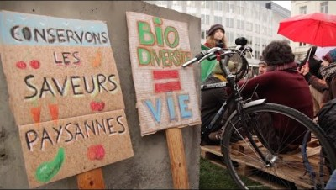

Slide 27
Notes:
SLIDE MENTIMETER 13 – 14 – 15 – 16 - 17

Slide 28

(Module 2) INTRO
• Quick warm-up: share one daily food/drink habit
• Today’s aims:
– Deconstruct preconceived ideas about food systems
– Trace how everyday foods link to global networks & power
13
Notes:
Speaker MENTIMER 13
“We already know each other—so one quick warm-up: name one daily food/drink habit (e.g., morning espresso, yogurt, instant noodles).”
“Keep it to one sentence; I’ll jot a few on the board. We’ll use these examples later to reveal the global chains behind them.”
“Our goals: challenge what feels ‘simple’ and map power and logistics behind everyday products.”

Slide 29

Practical Exercise:
The Journey of a Coffee Cup
• Object : moka pot (smell • sound • sight)
• Elements to list: beans • water • moka • energy • cup • spoon • sugar/milk
• Where from? Who made it? How transported?
• Follow the money: Who earns? Who sets price & availability?
• Outcome: reveal people, places, processes behind one simple cup
Notes:
“Let’s ‘read’ this moka. One cup involves many chains.”
“Beans: origin (e.g., Brazil/Ethiopia), farming system, certification, roasting and packaging.”
“Water & energy: utilities, grid/gas; cost and environmental footprint.”
“Moka: aluminum/steel supply, manufacturing, distribution; maintenance & lifespan.”
“Cup/spoon: materials (ceramic/steel), production, transport; dishwashing energy.”
“Sugar/milk: sugarcane/beet chains; dairy or plant-based alternatives.”
“For each: where from, who made it, how it moved, who earns, who decides price/availability.”
“Goal: see the actors & power in a daily act—this prepares us for value chains, Big Food, and crises.”

Slide 30
How many people & countries are “in” one coffee?
Coffee beans (10 g roasted): ~90–200 people
(farmers/pickers → wet & dry mills → co-op/export → trucks/ports → ship crew → import/roastery/packaging → distributor → retail staff)
Water & energy: ~5–15 (utility/grid roles touching this use)
Retail checkout/logistics (this purchase): ~5–12
Embedded chains (the durable objects & add-ons)
Aluminum moka pot (once, not per cup): ~160–430
(bauxite mine → alumina refinery → smelter → foundry/die-casting → assembly/QC → packaging → logistics → retail)
Ceramic cup (once): ~65–165
Stainless steel spoon (once): ~140–360
Sugar (5 g, per cup): ~60–130
Coffee packaging (bag/film/label, amortized): ~30–70
Certifiers/finance/insurance/waste (shared): ~10–25
Order-of-magnitude totals
Per-cup operational touchpoints: ~120–250 people
Adding embedded objects (first time you use them): +~400–950
Grand ecosystem (cup + embedded): ~520–1,200 people
Countries touched (typical): 10–16
Notes:
Message: Even a “simple” moka involves hundreds of workers and dozens of firms across ~10–19 countries. Food isn’t just calories; it’s chains, power and places.
What’s in each count (quick checklist)
Coffee beans (10 g roasted, ≈12 g green)
Farm household (3–5) + seasonal pickers (5–20)
Cooperative/wet mill (8–15), dry mill (10–20)
Local trucking (2–4), export office (5–12), port handlers (10–20)
Ship crew (20–25), import customs/warehouse (5–10)
Roastery (8–20), packaging line (3–6)
National distributor/DC (5–10), store receiving + shelf + cashier (5–15)
Water & energy
Water plant ops (1–3), grid/power roles touching household use (4–12)
Moka pot (aluminum, one-off)
Bauxite mining (10–30), alumina refinery (20–50), smelter (50–150)
Ingot/rolling/extrusion (20–50), die-casting/assembly/QC (30–80)
Packaging (5–10), logistics & ports (10–20), wholesale/retail (5–10)
Ceramic cup (one-off)
Kaolin/clay mining (10–30), glaze/chemicals (5–15)
Ceramic factory (forming, firing, decoration) (30–80)
Packaging (5–10), logistics & retail (10–30)
Stainless steel spoon (one-off)
Iron ore/coking coal mining (20–60), steelmaking (50–150)
Rolling/wire (20–50), utensil stamping/polish (30–70)
Packaging (5–10), logistics & retail (10–20)
Sugar (5 g, per cup)
Cane/beet growers & harvesters (10–30), mill/refinery (30–60)
Logistics (10–20), packaging/retail DC (5–10)
“Other hands” often invisible
Certification & audits (2–5), finance/insurance (3–8), standards/testing (1–3), municipal waste/ recycling (5–10)

Slide 31
How many people & countries are “in” one coffee?
Total people involved: ~520–1,200
Countries involved: ~16–19

Slide 32
Globalized Food Systems: What’s at Stake (Module 2)
• Value chains: who captures value? who is a price taker?
• Trade dependence: exports/imports, staples & farm inputs
• “Big Food” effects: consolidation, UPFs, land & processing power
• Crisis exposure: prices, logistics chokepoints, climate shocks
• Access inequalities: malnutrition ↔ waste, “food apartheid” patterns
• Our task today: diagnose risks → pick levers for change
Notes:
“In Module 2 we look at the system level: chains, trade, and who holds power.”
“First, value chains: where is value captured, and where are farmers/workers price takers?”
“Second, trade dependence: what we must import (staples, feed, fertilizers) and what we must export to survive.”
“Third, the role of Big Food: consolidation in seeds, trading, retail; ultra-processed foods shaping diets; land and processing hubs steering territories.”
“Fourth, crises: price spikes, fragile logistics, and climate extremes create cascade risks in long chains.”
“Fifth, inequalities of access: cheap UPFs vs costly fresh foods; place, race, gender, and income shape diets; we see malnutrition next to waste.”
“Goal for today: use quick diagnostics to make these issues visible and select realistic levers to act.”
Biblio:
“Reading anchors for this lens: Patel (2007) on power/concentration; Gálvez (2018) on trade & diets; Reese (2019) on access/justice; Shiva (2015) on agroecology; Moseley (2022) on decolonizing paths; Abis (2024) on shocks/logistics; Attac (2009) on EU levers.”

Slide 33
Globalized Food Systems - How Global Value Chains Work
• Longer chains, tighter contracts: standards, specs, certifications
• Upstream power: seeds, agrochemicals, machinery, finance
• Downstream power: traders, processors, brands, retailers
• Farmers/workers as price takers; margins captured in coordination & branding
• Switching costs & lock-ins (inputs, platforms, buyers)
• Result: efficiency claims, concentration of value & decision power
Notes:
Global chains are long and rule-heavy: standards and contracts shape what can be produced and sold.
Power concentrates upstream (seeds, inputs, machinery, credit) and downstream (traders, processors, brands, retailers).
Farmers and many workers are price takers; most profit sits in coordination, logistics, data, and branding.
Lock-ins matter: dependence on specific seeds/chemicals, platforms, or a single buyer makes switching costly and risky.
Sure there is more efficiency BUT often comes with loss of local decision power and value capture.
These elements sets up trade dependence and Big Food effects on the next slides.

Slide 34
Globalized Food Systems - Export / Import Dependence
2 Staple & input reliance: wheat, maize, soy, fertilizers, fuel
3 Export specialization: few products → exposure to price swings
4 Trade balance risks: FX needs, debt, policy shocks
5 Logistics chokepoints: ports, corridors, cold chain
6 Metric to watch: Import Dependency Ratio (IDR) for staples/inputs
=> Sovereignty question: what must we import and what must we export to cope?
Notes:
1 Many territories rely on imported staples and farm inputs (fertilizers, feed, fuel).
=> 2 Export specialization in a few commodities raises
3 volatility: when prices fall, incomes drop; when inputs rise, costs spike.
4 The trade balance matters: foreign exchange (FX) needs and debt make policies more fragile.
5 Logistics chokepoints—a single port, corridor, or cold chain link—can disrupt supply.
6 FS LENS: Use a quick metric: IDR = share of availability coming from imports;
Sovereignty lens: map what you must import to eat or produce, and what you must export to pay bills; reduce single-point dependencies.

Slide 35
14/17
Notes:
SLIDE MENTIMETER 14 – 15 – 16 – 17 – 18 (6 slides fino a question 7)

Slide 36
“Big Food”: What Changes?
Big Food = the large, powerful companies that make, trade, market, and sell most of our food and drinks (from seed and grain traders to snack/beverage brands, supermarkets, and fast-food chains). They shape what we eat and how it’s produced through their market power, branding, supply chains, and lobbying.
• Consolidation across seeds/chemicals, grain trading, processing, retail
• Shelf power & marketing shape diets → rise of ultra-processed foods (UPFs)
• Standards/specs can exclude smallholders; private audits add costs
• Territorial shifts: contract farming, land grabs, processing hubs
• Price formation moves upstream/downstream; farmers stay price takers
• Net effect: concentrated value & decision power along the chain
19
Notes:
Consolidation means fewer, larger firms at key nodes: seeds/inputs, traders, processors, retailers.
Shelf power & marketing influence what people buy; this drives UPF expansion and uniform products.
Private standards/specs and audits can raise barriers and costs for small producers.
Territorial shifts happen: contract farming, land concentration, and centralized processing hubs.
Price formation is controlled upstream/downstream; producers remain price takers with thin margins.
Mentimeter slide 18
Overall, value and decisions concentrate far from farms and communities—key issue for sovereignty.

Slide 37
“Big Food” - Land, Labor, Territory
• Land concentration and insecure tenure (especially for women and smallholders)
• Contract farming and vertical integration reshape who controls production
• Migrant & seasonal labor: low wages, precarity, housing and status issues
• Export enclaves vs local provisioning: divergent pathways in the same region
• Environmental spillovers: water use/pollution, soil loss, biodiversity impacts
• Territorial question: who controls land, labor, processing, and logistics?
Notes:
Land concentration limits farmer agency; precarious tenure reduces long-term investment, often affecting women most.
Contract farming and vertical integration shift decision power to buyers/processors (inputs, specs, prices).
Migrant/seasonal labor is essential yet often precarious (wages, status, housing), shaping their food access and well-being.
Export enclaves may grow GDP but weaken local food provisioning and resilience.
Environmental spillovers (water, soils, biodiversity) accumulate locally while value moves elsewhere.
Territorial sovereignty asks: who controls key assets and rules—and how can communities regain room for manoeuvre?
Question to you???
“Which territorial issue is most pressing where you are?”
Options: Land access/tenure • Labor conditions • Contract farming lock-ins • Processing bottlenecks • Water/soil stress

Slide 38
“Big Food” - Vulnerabilities to Crises
• Price shocks: food, energy, fertilizers → fast cost/pass-through
• Logistics fragility: ports, corridors, trucking, cold chain
• Single points of failure: one buyer, one supplier, one route
• Climate extremes: heat, drought, floods, pests → yield & storage losses
• Financial stress: FX, debt, interest rates tighten farm cash flow
• Cascade risk: long chains + concentration = rapid system stress (??)
Notes:
Price shocks in food, energy, and fertilizers hit both producers and consumers quickly.
Logistics fragility: delays at ports, blocked corridors, or a broken cold chain spoil product and raise costs.
Look for single points of failure: a single buyer, single supplier, or single route creates high risk.
Climate extremes (heat, drought, floods, pests) cut yields and damage storage; recovery takes time.
Financial stress grows with foreign exchange needs, debt, and interest rates, squeezing liquidity.
Together, these create cascade risk: problems travel fast along long, concentrated chains.
esempi in francia:
Slide — France: Logistics Disruptions (Economic • Social • Geopolitical)
• Red Sea/Suez detours: longer routes via Cape → higher freight, 10–14 days delay, input/packaging costs up
• Port shocks (Le Havre, Marseille-Fos): strikes/backlogs → cold-chain risk, stockouts, extra trucking
• Inland waterways: low river levels reduce barge loads → shifts to road, higher costs and delays
• Fertilizer geopolitics: reduced Russian N & Belarusian potash → tighter supply, price volatility for farms
• Panama Canal drought: fewer transits → global vessel re-routing, container imbalances hitting EU flows
• Pass-through to consumers: SMEs’ costs rise; fresh imports and staples see price pressure
• Policy response cues: diversify routes/suppliers, build buffers, use public procurement to localize demand

Slide 39
“Big Food” - Access Inequalities: Malnutrition ↔ Waste
• Cheap UPFs, costly fresh foods: price, promos, shelf placement drive choices
• Place & mobility: transport/time barriers in peri-urban & rural areas
• Income & gender: low wages, unpaid care work constrain diets
• Racialized geographies: “food apartheid” patterns, safety/quality gaps
• Paradox: undernutrition & obesity coexist; surplus & waste at many nodes
• Sovereignty lens: shift from calories to power, dignity, participation
Notes:
Prices and promotions in supermarket favor ultra-processed foods (UPFs); fresh foods cost more in money and time.
Place matters: limited transport and time make access to fresh food harder outside city centers.
Income & gender constraints: low pay and unpaid care reduce money and time for cooking and shopping.
Racialized geographies: some neighborhoods face lower quality, fewer outlets, and safety concerns.
The system creates a paradox: undernutrition VS obesity, plus significant waste from farm to fridge.
Food sovereignty asks for power, dignity, and participation in food decisions, not just more calories.
Bridge: next we choose quick diagnostics to make these inequalities visible and target levers.

Slide 40
Introduction - Quick Diagnostics
1 Import Dependency Ratio (IDR): % of a staple/input that comes from imports
2 Concentration proxy: share of market held by top 3–4 suppliers/buyers
3 Food environment scan: UPF exposure, price basket (fresh vs UPF), shelf placement
4 Shock map: find single points of failure (one port, one route, one buyer)
5 Labor/land check: seasonal labor reliance, tenure security for smallholders/women
6 Pick 1–2 tools for your territory/product today
Notes:
Start with IDR for one staple (e.g., wheat) or one input (e.g., fertilizers, soymeal).
Build a concentration proxy: estimate how much the top 3–4 buyers/suppliers control.
Do a food environment scan: compare prices, promotions, and UPF exposure to fresh options.
Draw a shock map: highlight ports, corridors, buyers where a single failure would halt supply.
Add a labor/land check: note seasonal labor dependency and tenure/security issues.
Choose one or two diagnostics to run now; they will point to concrete levers next.

Slide 41
Notes:
SLIDE MENTIMETER 20/25
risposte corrette:
Q1 — Chain mapping (multi-select)
Correct:
Wheat farming; Grain collection/storage; Milling (flour); Yeast & salt supply; Water & energy; Artisan bakeries; Industrial bakeries; Distribution/retail.
Why: All are core stages/resources in the French bread chain.
Incorrect (distractors): Coffee roasting; pasta processing — unrelated to bread.
Q2 — Import dependence snapshot (single select)
Best answer: Fertilizers for wheat.
Why: France exports wheat but relies substantially on imported nitrogen/potash (and gas-linked N). Yeast may use imported inputs, but fertilizer dependence is broader and more systemic.
Others: Wheat/flour/energy often less import-dependent overall for France; table salt/herbs not central.
Q3 — Market concentration risk (ranking)
Indicative ranking (1 = highest):
Retail chains (large buyers set terms/shelf)
Milling (top firms hold big shares)
Industrial bakeries (few large players)
Yeast manufacturers (specialized, few)
Grain trading/collection (co-ops/traders vary by region)
Packaging design agencies (distractor)
Why: Pricing and specs often set downstream; milling commonly concentrated; industrial/yeast can be tight; grain collection varies locally.
Q4 — Logistics chokepoints (multi-select)
Select:
Port delays for inputs; Rail/truck strikes; Fuel price spikes; Regional grain storage bottlenecks; (and, secondarily) Cold chain for yeast/butter.
Why: These can disrupt flour/inputs movement, baking schedules, and costs.
Don’t select (distractors): Airport closures; Reefer container shortage for fresh fish — low relevance to bread.
Q5 — Price pass-through (scale 1–7)
Typical result to expect: 5–7
Why: Energy shocks hit milling, baking (ovens), and transport; baguette prices often react within weeks–months.
Q6 — First diagnostic to compute (single select)
Good choices (pick one based on your focus):
Market concentration in milling (HHI or top-3/4 share): best if you’re probing pricing power.
IDR for fertilizers: best if you’re probing import exposure on inputs.
Also valid: Energy cost share (if baker viability is the issue); Chokepoint map (if strikes/ports are salient).
Avoid: HHI for bakery décor suppliers (not material).
Q7 — Pick one lever (ranking, 1 = best)
Suggested ranking (context-dependent):
Co-op storage & logistics for grain/flour (buffers + bargaining)
Energy support for artisan bakeries (efficiency/ovens to handle energy shocks)
Public procurement for local flour (anchor demand, stable contracts)
Fair contracts (cost-plus) with retailers (share risk, stabilize margins)
Subsidy shift toward agroecological wheat (medium-term input resilience)
TV advertising campaign for baguettes (distractor)
Why: Tackle immediate bottlenecks (logistics/energy), then secure demand and fair terms; structural agronomy shifts build medium-term resilience.

Slide 42
From Diagnosis to Levers
• If IDR (imports) is high → diversify sources, local substitution, buffer stocks
• If market concentration is high → co-ops & local processing, fair contracts, antitrust watch
• If logistics chokepoints → route diversification, shared storage, contingency plans
• If UPF exposure / access gaps → public procurement, price baskets, retail zoning
• If energy shocks → bakery efficiency upgrades, collective purchasing, time-of-use
• Always check equity (who benefits) and feasibility (12–24 months)
Notes:
Match diagnosis → lever.
Imports: diversify, substitute, hold buffers.
Concentration: build co-ops, add processing, push fair contracts.
Chokepoints: add routes/storage, make plans.
Access/UPFs: use procurement, regulate retail mix, track prices.
Energy: invest in efficiency and collective buying.
Weigh equity, ecology, feasibility before choosing.

Slide 43
Wrap & Bridge to Cases
• Globalization → power shifts, dependencies, shocks, inequities
• Your toolkit → IDR, concentration proxy, food environment scan, shock map
• Next step → apply to a product/territory and pick one lever to test
• Measure success by resilience + equity + agency, not volume alone
Notes:
Recap: we saw where risks sit and who holds power.
Use one diagnostic now; choose a realistic lever.
This sets up the case activity and links to Module 3 on power & justice.

Slide 44
Grazie

Slide 45
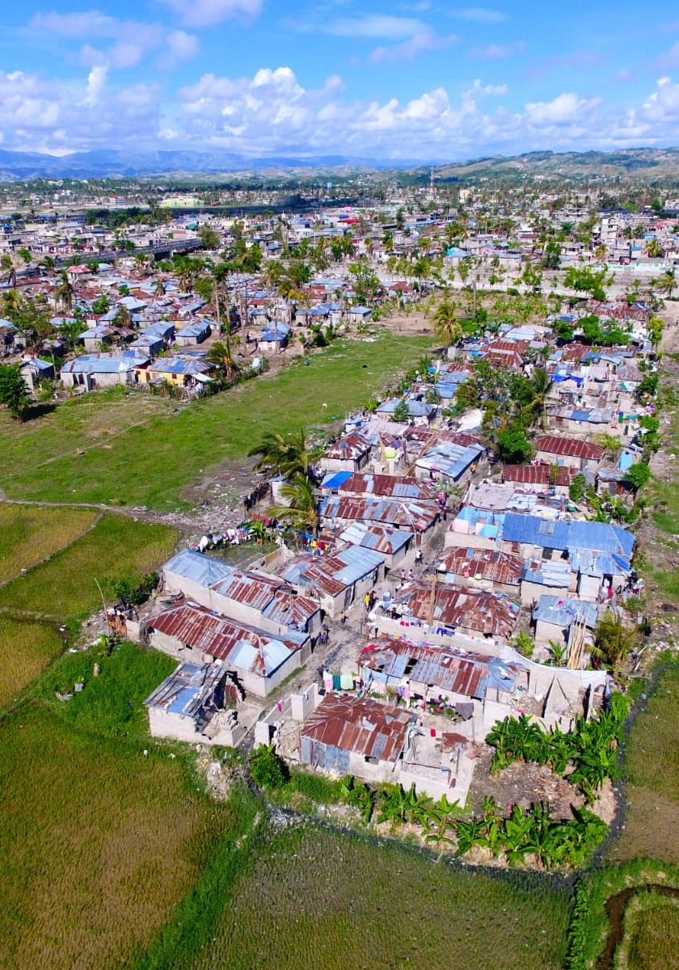
Case Study: Les Cayes (South Haiti)
Where: Les Cayes & Macaya uplands
Topic: Coffee in Jardin Créole systems
Goal today: understand context & actors to place the project
Output later: your stakeholder map + next moves
Notes:
Recap: we saw where risks sit and who holds power.
Use one diagnostic now; choose a realistic lever.
This sets up the case activity and links to Module 3 on power & justice.

Slide 46
Why it matters
We target food sovereignty outcomes (who decides)
Need to know who holds power, who contributes, where risks are
This guides who to engage and who to neutralize
Mapping first; solutions after.
Notes:
Recap: we saw where risks sit and who holds power.
Use one diagnostic now; choose a realistic lever.
This sets up the case activity and links to Module 3 on power & justice.

Slide 47
Landscape & farming
Jardin Créole: mixed crops/trees, looks “messy” but feeds families
Coffee often with cacao and other species → side incomes
Degradation: deforestation, soil erosion; hurricanes hit hard (e.g., Matthew)
Agroecology exists, but under stress!
Notes:
Recap: we saw where risks sit and who holds power.
Use one diagnostic now; choose a realistic lever.
This sets up the case activity and links to Module 3 on power & justice.

Slide 48
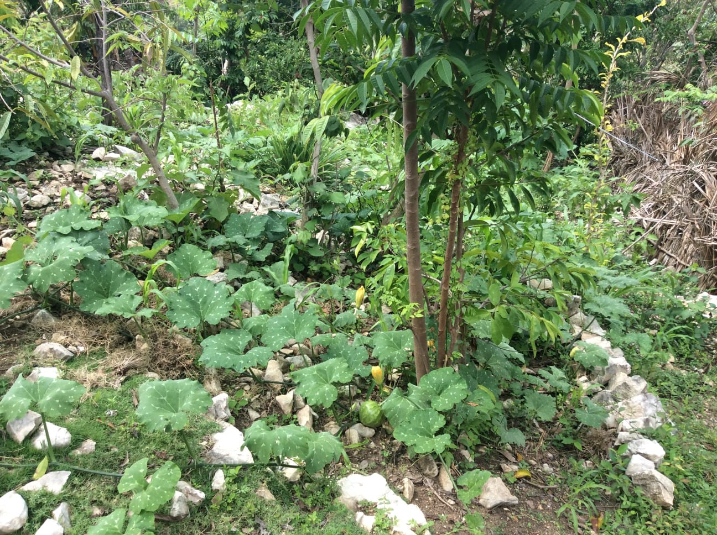
Notes:
Recap: we saw where risks sit and who holds power.
Use one diagnostic now; choose a realistic lever.
This sets up the case activity and links to Module 3 on power & justice.

Slide 49
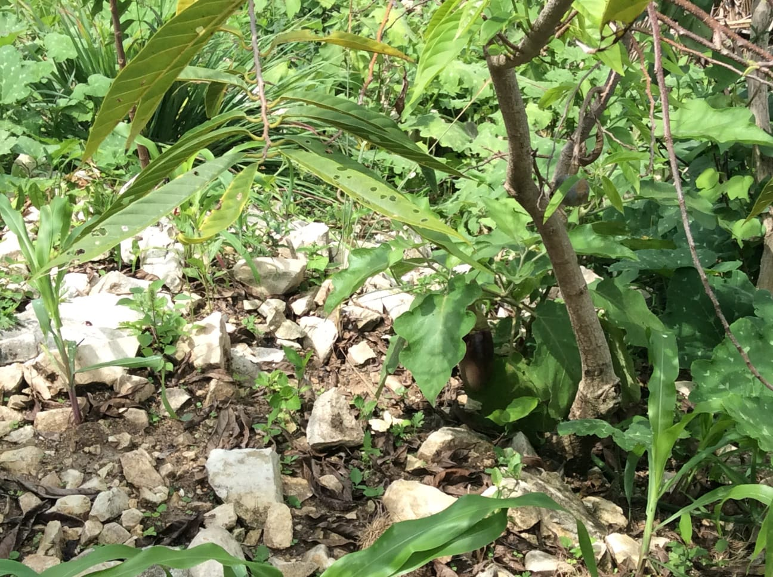
Notes:
Recap: we saw where risks sit and who holds power.
Use one diagnostic now; choose a realistic lever.
This sets up the case activity and links to Module 3 on power & justice.

Slide 50
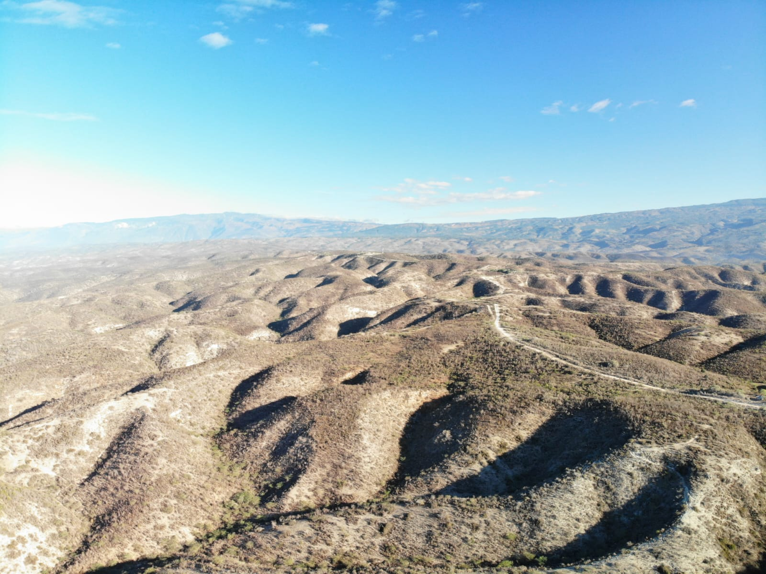
Notes:
Recap: we saw where risks sit and who holds power.
Use one diagnostic now; choose a realistic lever.
This sets up the case activity and links to Module 3 on power & justice.

Slide 51
Logistics reality
Mountain access: poor/no roads; mule/foot; landslides/bridges out
To the capital: gang‑controlled segments; checkpoints; extortion
Trade: ports/customs delays; storage limits; higher insurance costs
Moving people & coffee is risky and slow.
Notes:
Recap: we saw where risks sit and who holds power.
Use one diagnostic now; choose a realistic lever.
This sets up the case activity and links to Module 3 on power & justice.

Slide 52
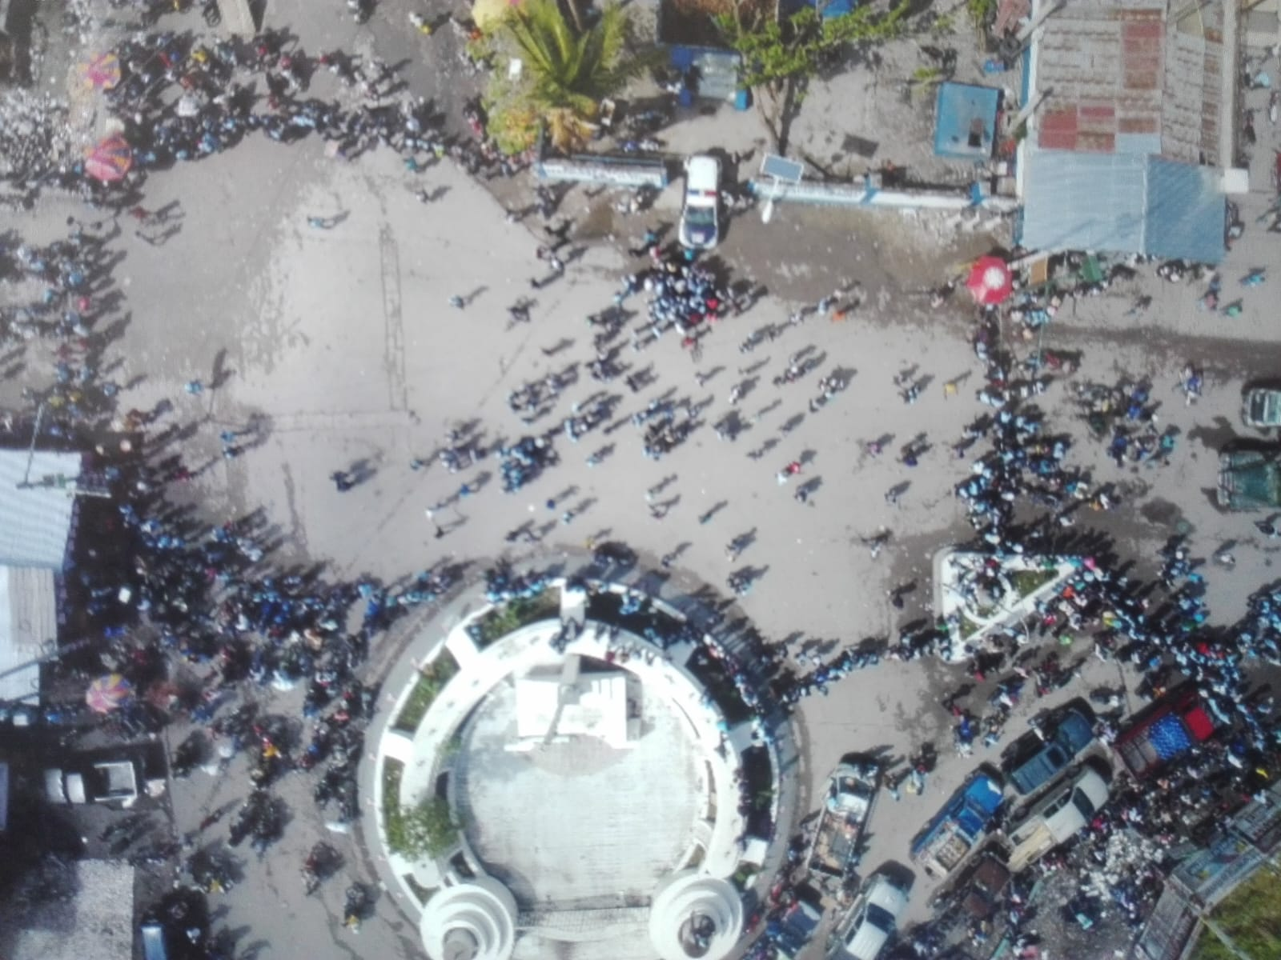
Notes:
Recap: we saw where risks sit and who holds power.
Use one diagnostic now; choose a realistic lever.
This sets up the case activity and links to Module 3 on power & justice.

Slide 53
Chain today (very short)
Farmers → coops/aggregators → Rebo → domestic/export
Supply gaps → imports by Rebo → less leverage for locals
Domestic demand under‑served (costs/risks > margins)
Notes:
Recap: we saw where risks sit and who holds power.
Use one diagnostic now; choose a realistic lever.
This sets up the case activity and links to Module 3 on power & justice.

Slide 54
Who matters (actors overview)
Producers: smallholders; coffee coops (partners/beneficiaries)
Market/private: Rebo, traders, transporters, MFIs/VSLAs, brand foundations
Public: Ministry (nat./dept.), municipal, ID services, environment/civil protection
Community/CSOs: NGOs, churches, Vodou, notables, diaspora, schools/universities
Donors/multilaterals: EU, Canada, US funds, FAO/UNDP
Security/stabilization: gangs (⚠), UN contingent (low acceptance)
Many layers; not all are allies.
Notes:
Recap: we saw where risks sit and who holds power.
Use one diagnostic now; choose a realistic lever.
This sets up the case activity and links to Module 3 on power & justice.

Slide 55
Key dynamics & risks
Imports weaken local bargaining
Domestic demand not met but not attractive to serve
Short‑term aid can distort farming incentives
State fragility + security threats + climate shocks
No ID/credit → low‑investment trap
These shape feasibility and pace
Notes:
Recap: we saw where risks sit and who holds power.
Use one diagnostic now; choose a realistic lever.
This sets up the case activity and links to Module 3 on power & justice.

Slide 56
Project focus (orientation only)
Strengthen smallholders & coops (governance, quality, fair sales)
Agroecology + hurricane resilience
Financial inclusion (ID → safe credit)
Neutral, community‑first, DO NOT HARM; no engagement with gangs
Notes:
Recap: we saw where risks sit and who holds power.
Use one diagnostic now; choose a realistic lever.
This sets up the case activity and links to Module 3 on power & justice.

Slide 57
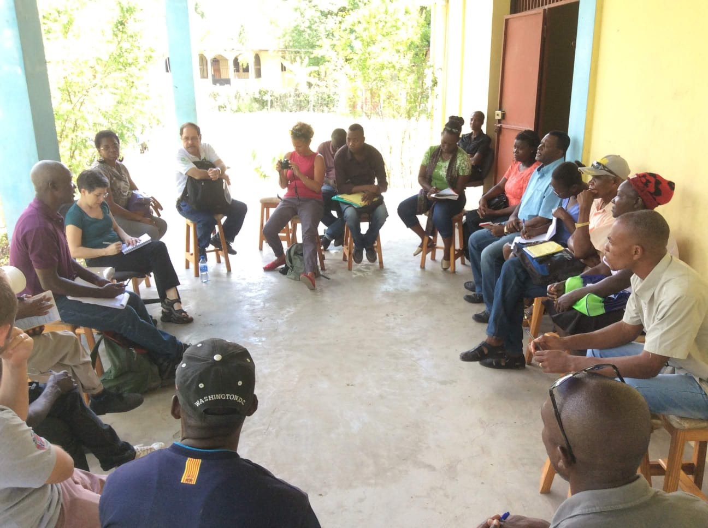
Notes:
Recap: we saw where risks sit and who holds power.
Use one diagnostic now; choose a realistic lever.
This sets up the case activity and links to Module 3 on power & justice.

Slide 58
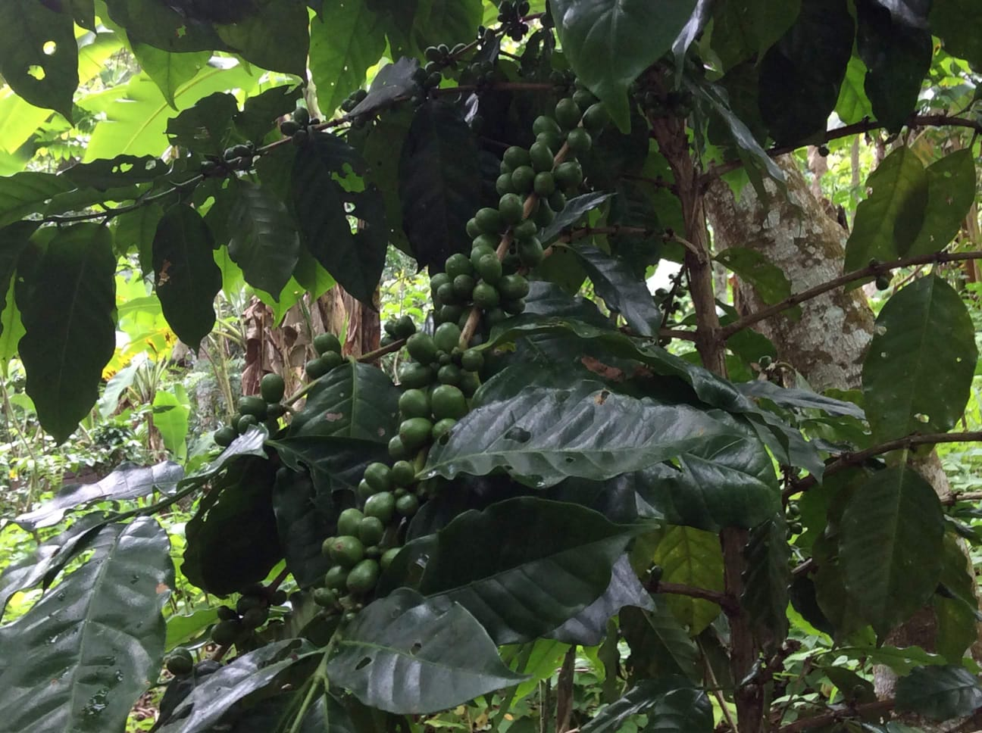
Notes:
Recap: we saw where risks sit and who holds power.
Use one diagnostic now; choose a realistic lever.
This sets up the case activity and links to Module 3 on power & justice.

Slide 59
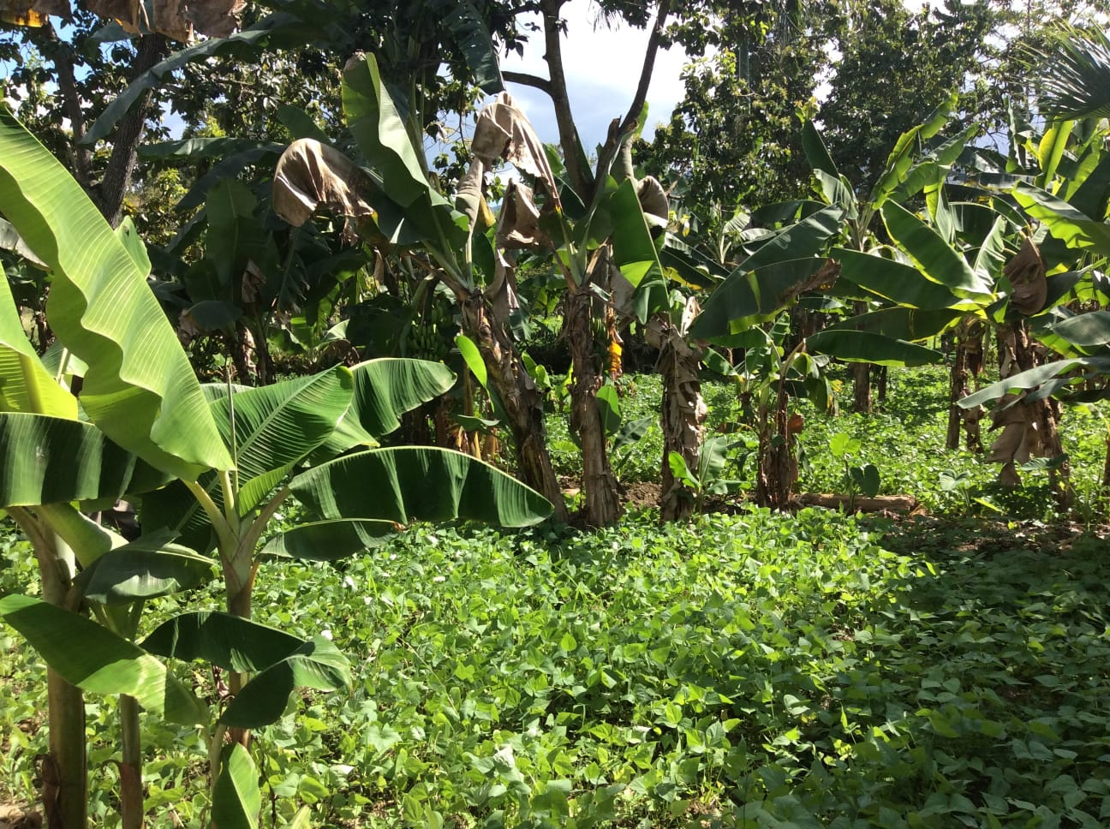
Notes:
Recap: we saw where risks sit and who holds power.
Use one diagnostic now; choose a realistic lever.
This sets up the case activity and links to Module 3 on power & justice.

Slide 60
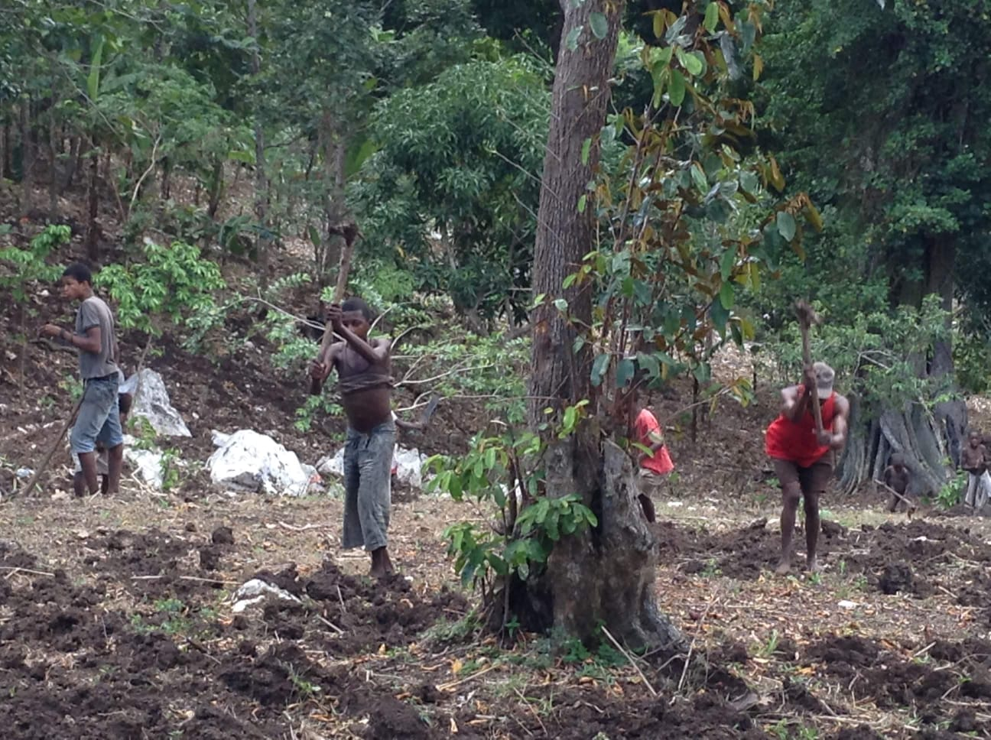
Notes:
Recap: we saw where risks sit and who holds power.
Use one diagnostic now; choose a realistic lever.
This sets up the case activity and links to Module 3 on power & justice.

Slide 61
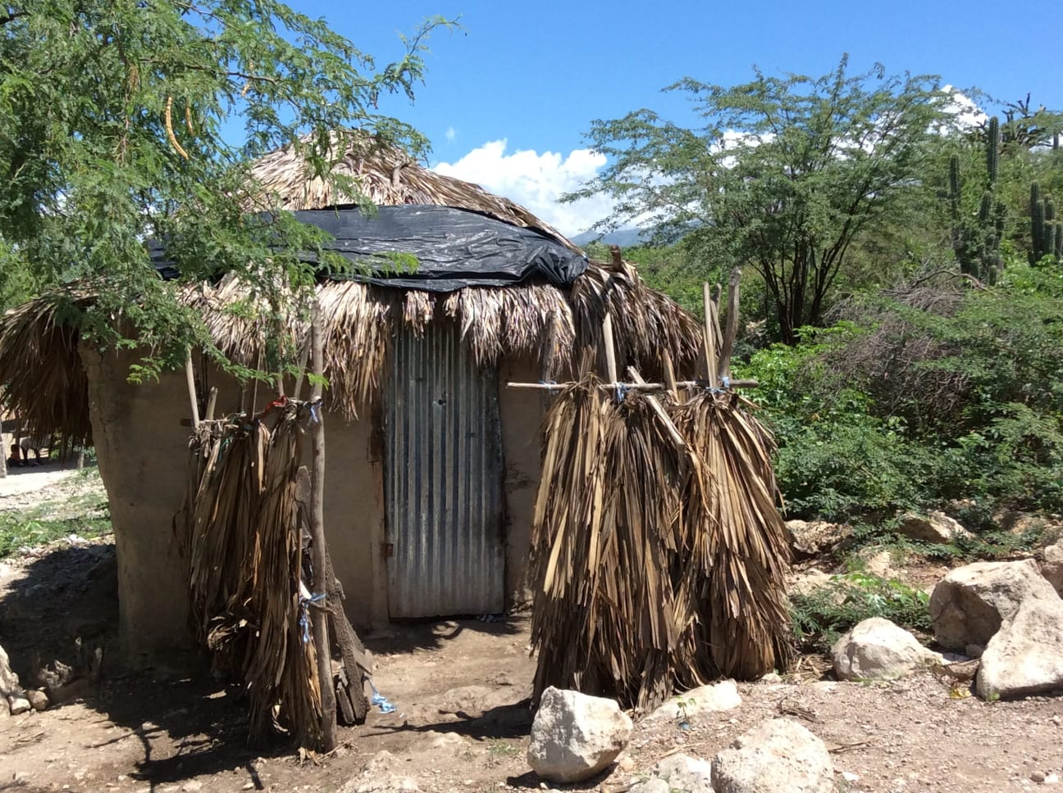
Notes:
Recap: we saw where risks sit and who holds power.
Use one diagnostic now; choose a realistic lever.
This sets up the case activity and links to Module 3 on power & justice.

Slide 62
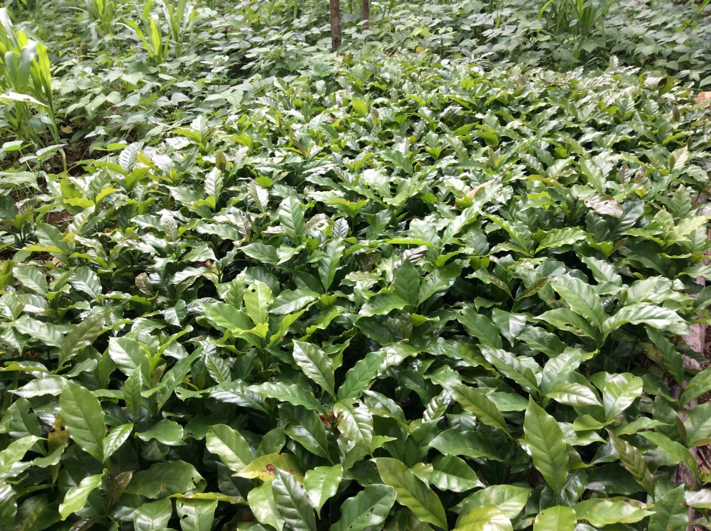
Notes:
Recap: we saw where risks sit and who holds power.
Use one diagnostic now; choose a realistic lever.
This sets up the case activity and links to Module 3 on power & justice.

Slide 63
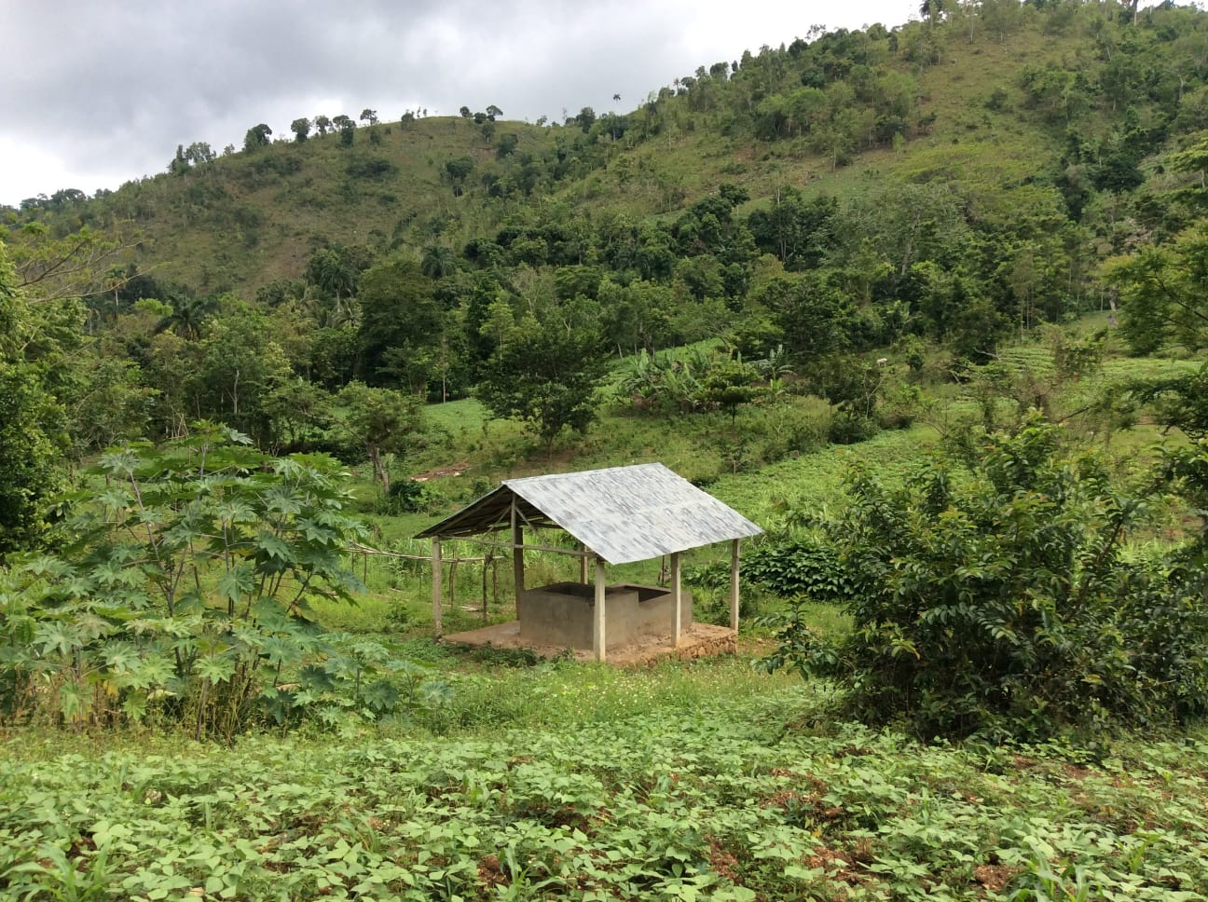
Notes:
Recap: we saw where risks sit and who holds power.
Use one diagnostic now; choose a realistic lever.
This sets up the case activity and links to Module 3 on power & justice.

Slide 64
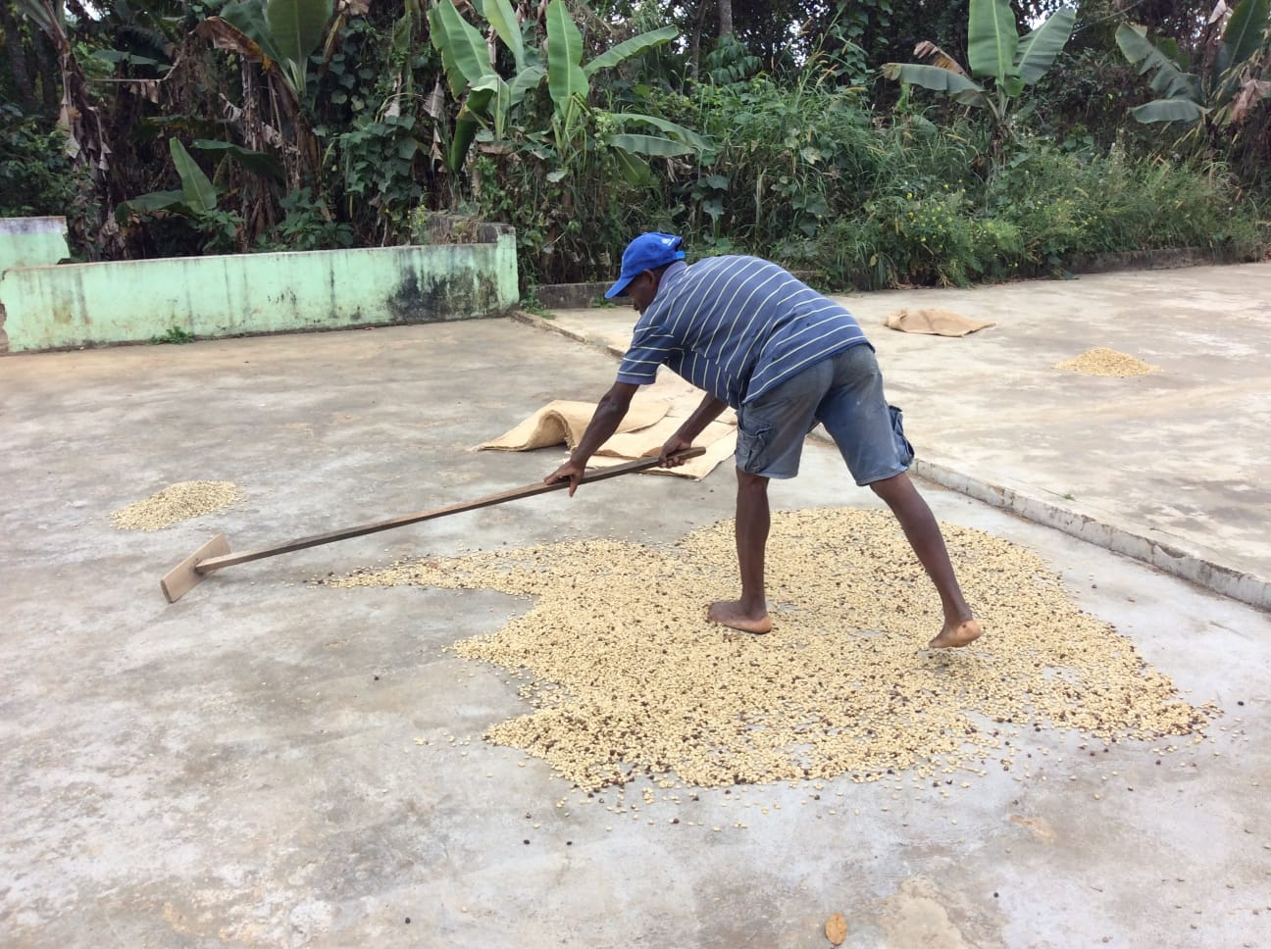
Notes:
Recap: we saw where risks sit and who holds power.
Use one diagnostic now; choose a realistic lever.
This sets up the case activity and links to Module 3 on power & justice.

Slide 65
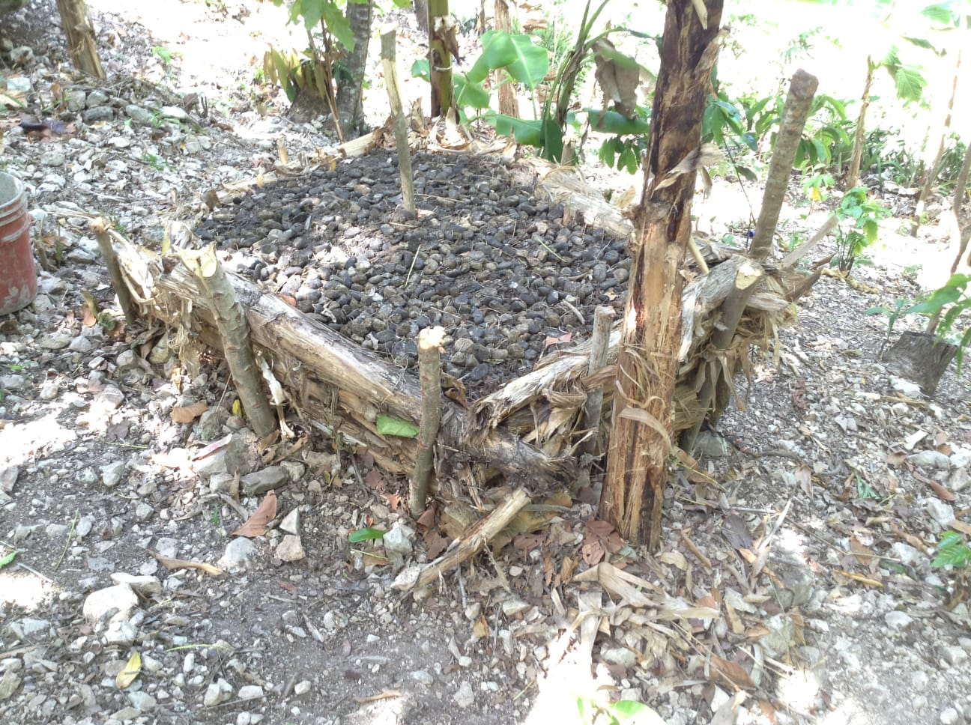
Notes:
Recap: we saw where risks sit and who holds power.
Use one diagnostic now; choose a realistic lever.
This sets up the case activity and links to Module 3 on power & justice.

Slide 66
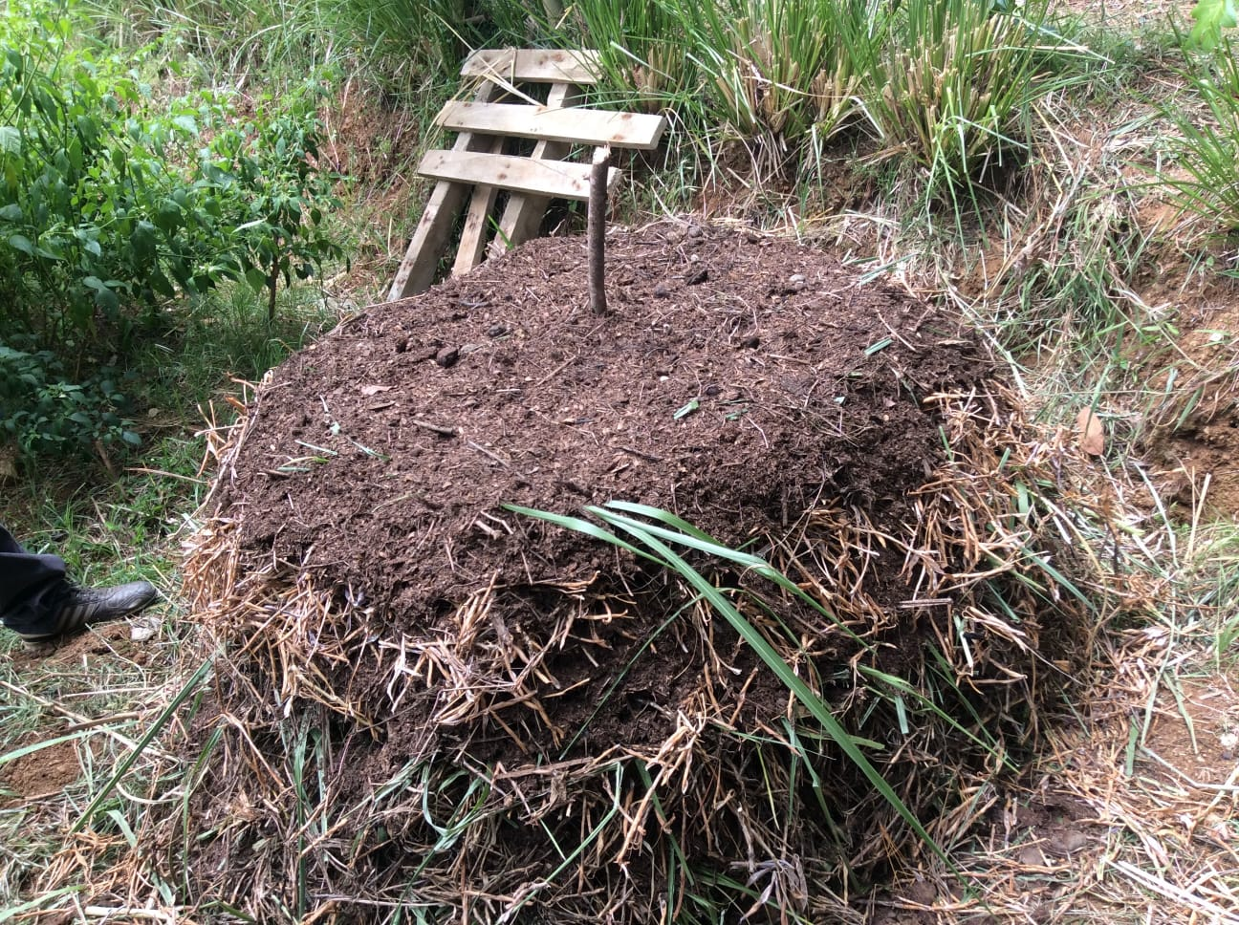
Notes:
Recap: we saw where risks sit and who holds power.
Use one diagnostic now; choose a realistic lever.
This sets up the case activity and links to Module 3 on power & justice.

Slide 67
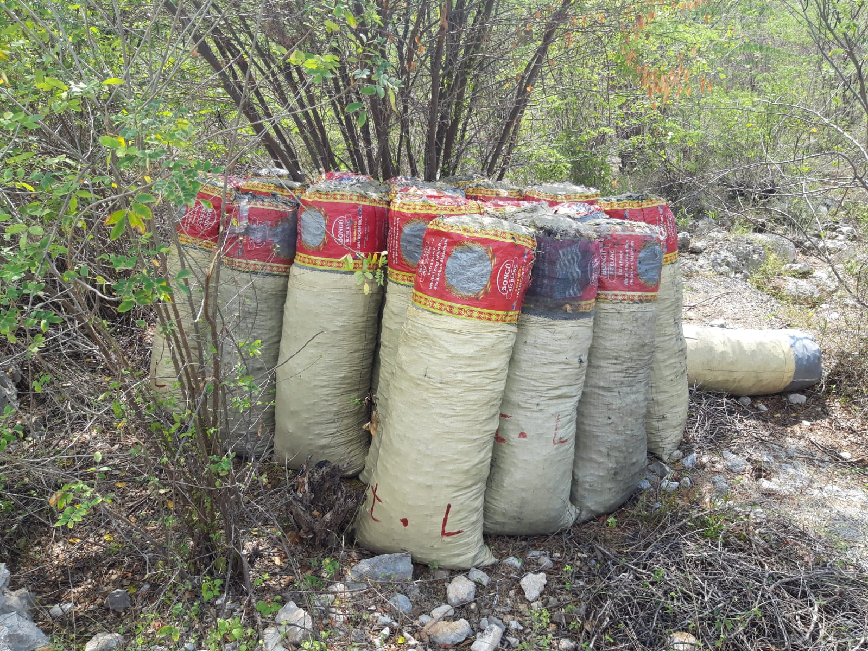
Notes:
Recap: we saw where risks sit and who holds power.
Use one diagnostic now; choose a realistic lever.
This sets up the case activity and links to Module 3 on power & justice.

Slide 68
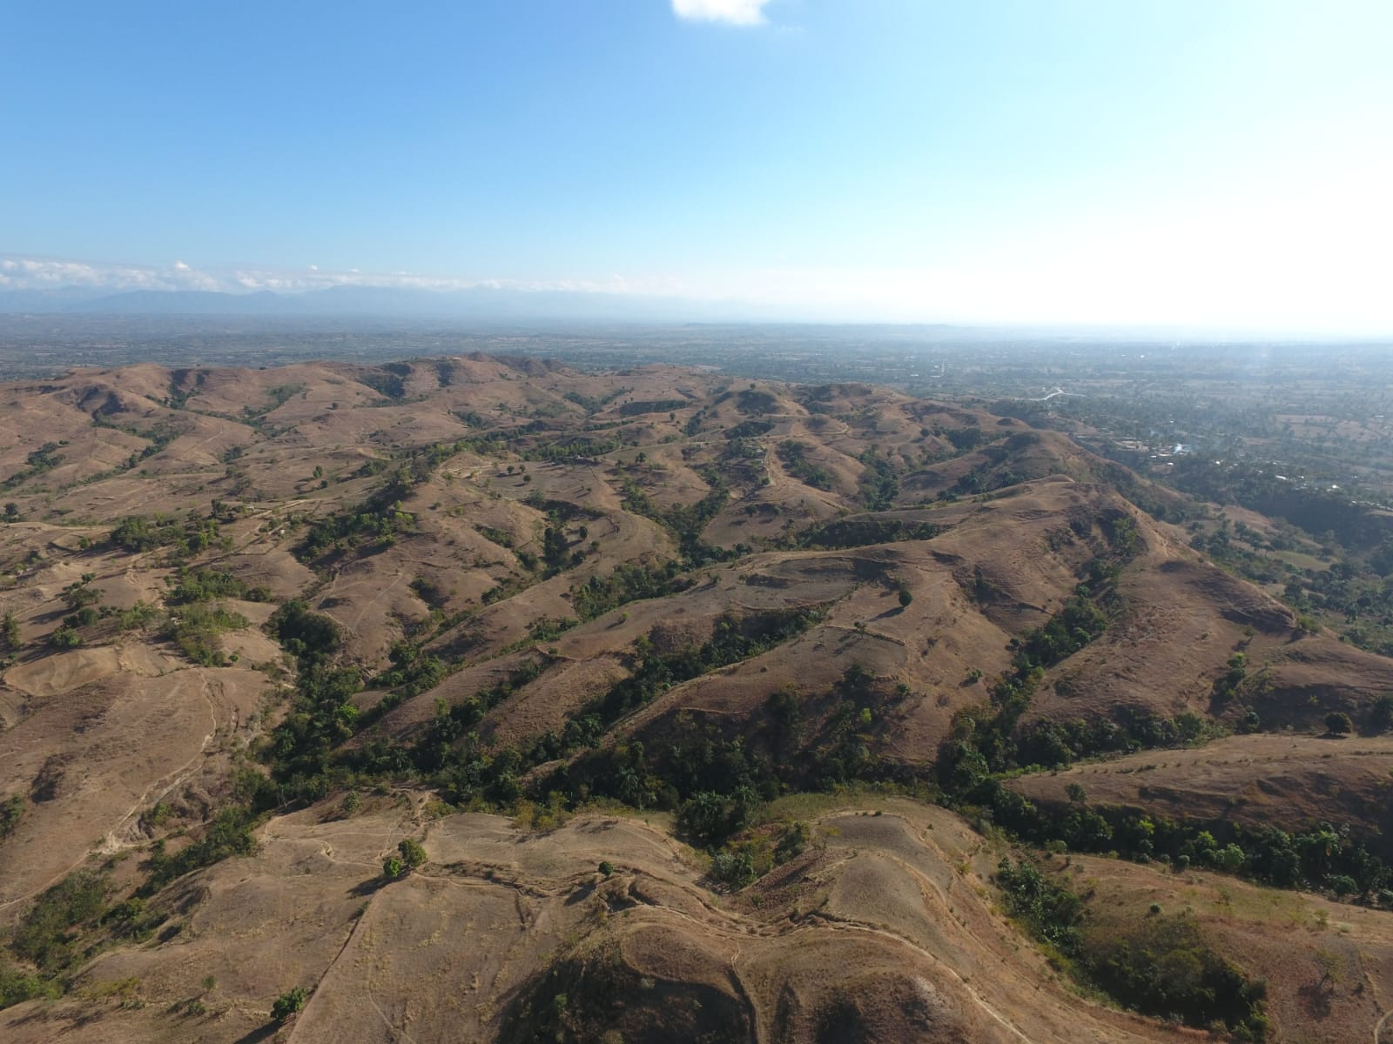
Notes:
Recap: we saw where risks sit and who holds power.
Use one diagnostic now; choose a realistic lever.
This sets up the case activity and links to Module 3 on power & justice.

Slide 69
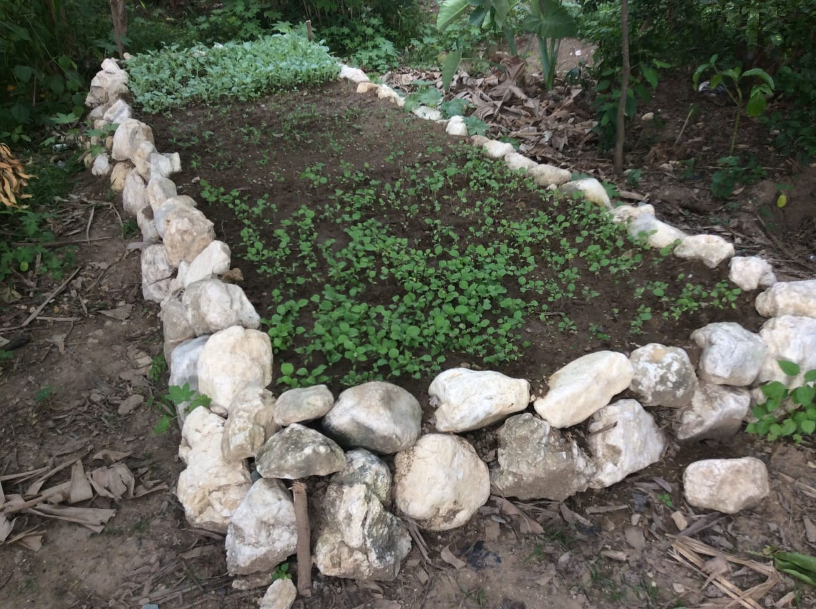
Notes:
Recap: we saw where risks sit and who holds power.
Use one diagnostic now; choose a realistic lever.
This sets up the case activity and links to Module 3 on power & justice.

Slide 70
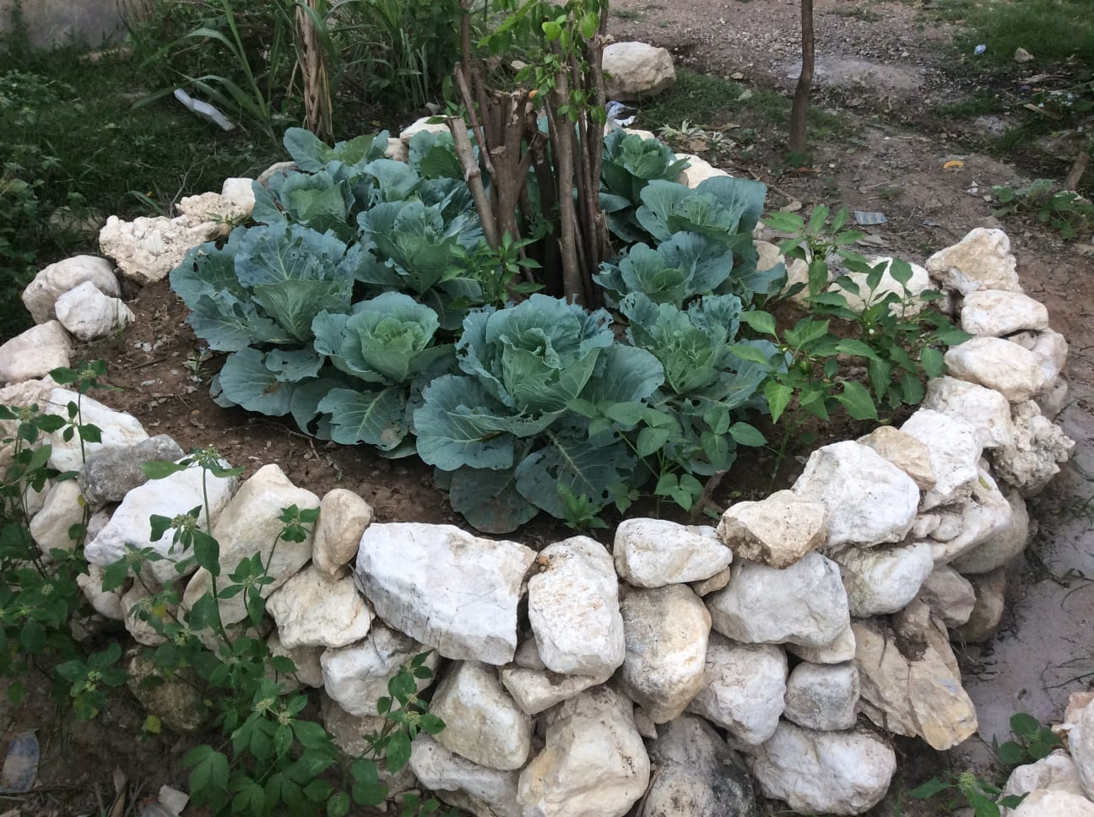
Notes:
Recap: we saw where risks sit and who holds power.
Use one diagnostic now; choose a realistic lever.
This sets up the case activity and links to Module 3 on power & justice.

Slide 71
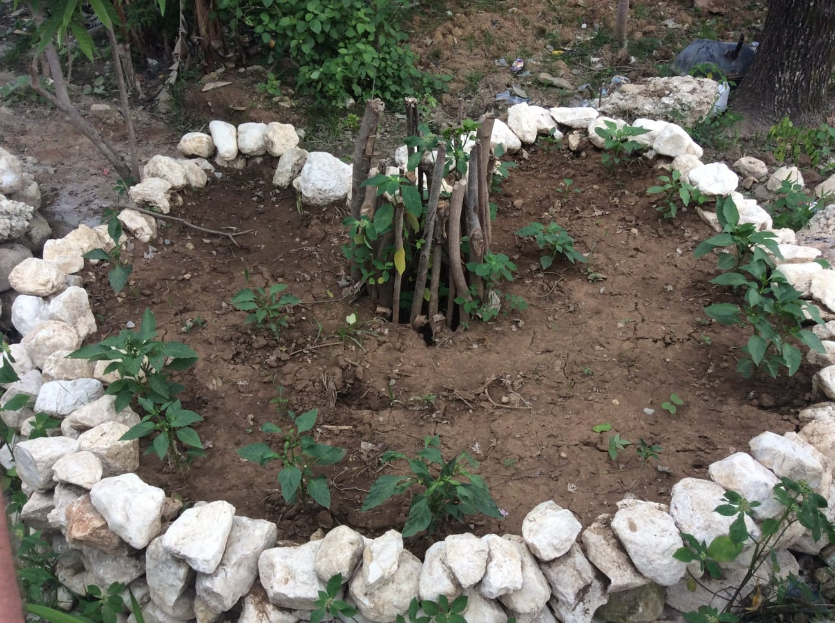
Notes:
Recap: we saw where risks sit and who holds power.
Use one diagnostic now; choose a realistic lever.
This sets up the case activity and links to Module 3 on power & justice.

Slide 72
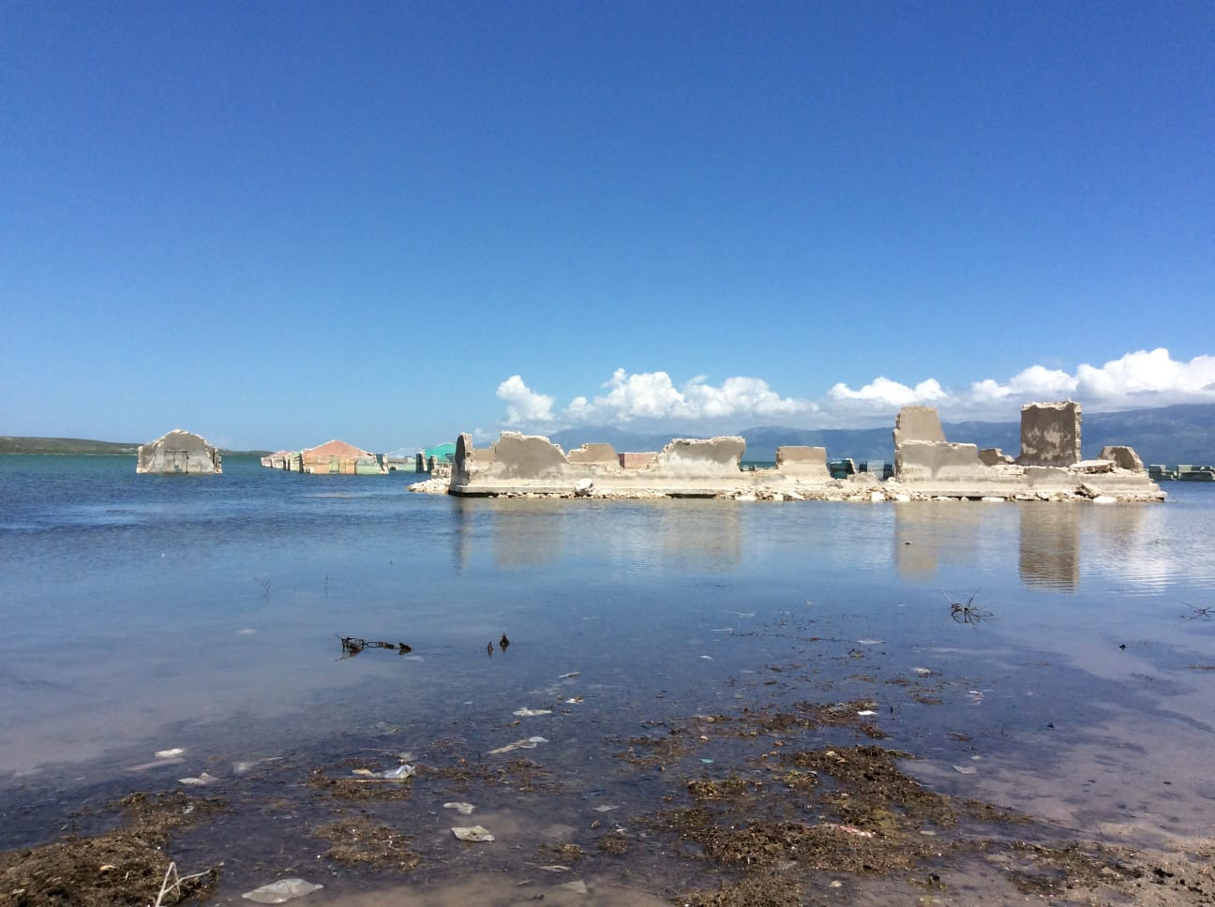
Notes:
Recap: we saw where risks sit and who holds power.
Use one diagnostic now; choose a realistic lever.
This sets up the case activity and links to Module 3 on power & justice.

Slide 73
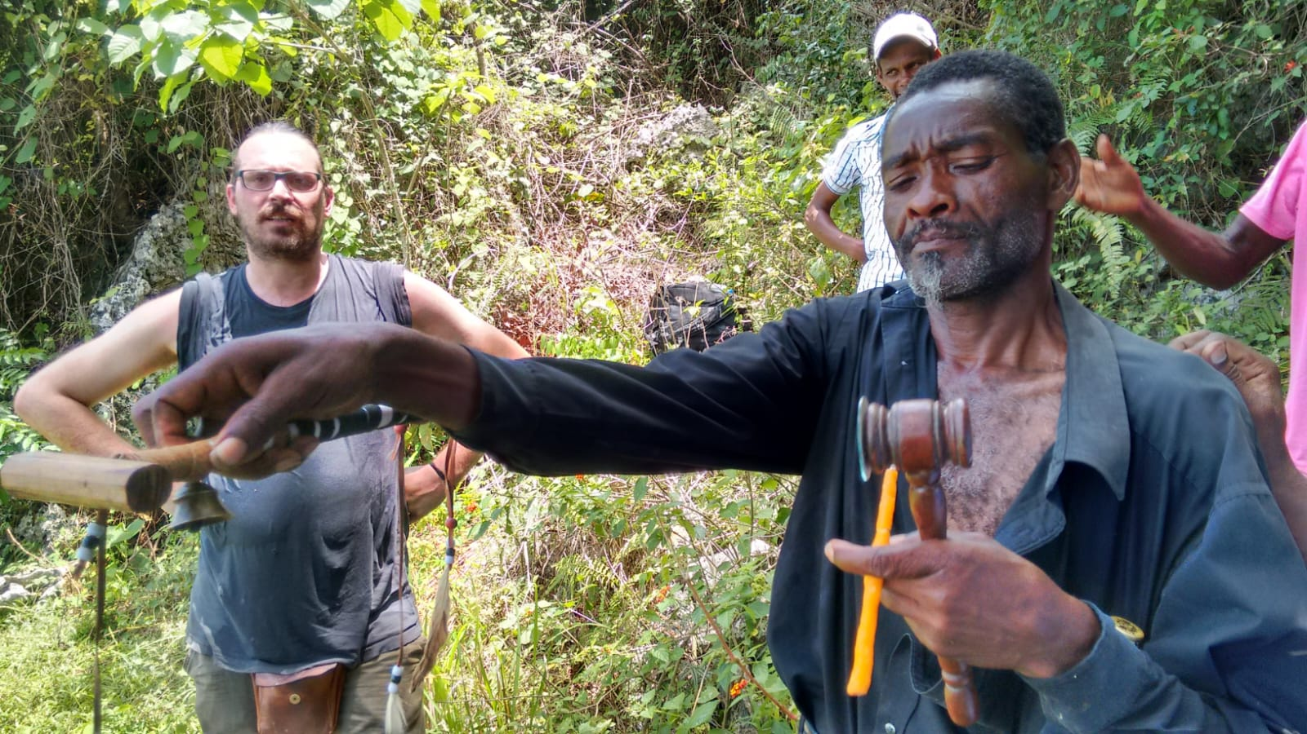
Notes:
Recap: we saw where risks sit and who holds power.
Use one diagnostic now; choose a realistic lever.
This sets up the case activity and links to Module 3 on power & justice.

Slide 74
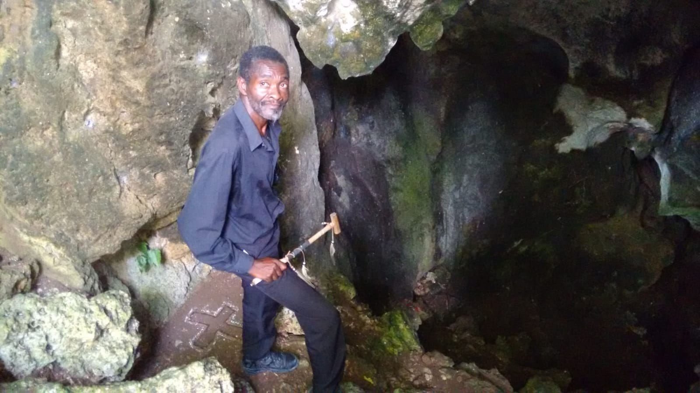
Notes:
Recap: we saw where risks sit and who holds power.
Use one diagnostic now; choose a realistic lever.
This sets up the case activity and links to Module 3 on power & justice.

Slide 75
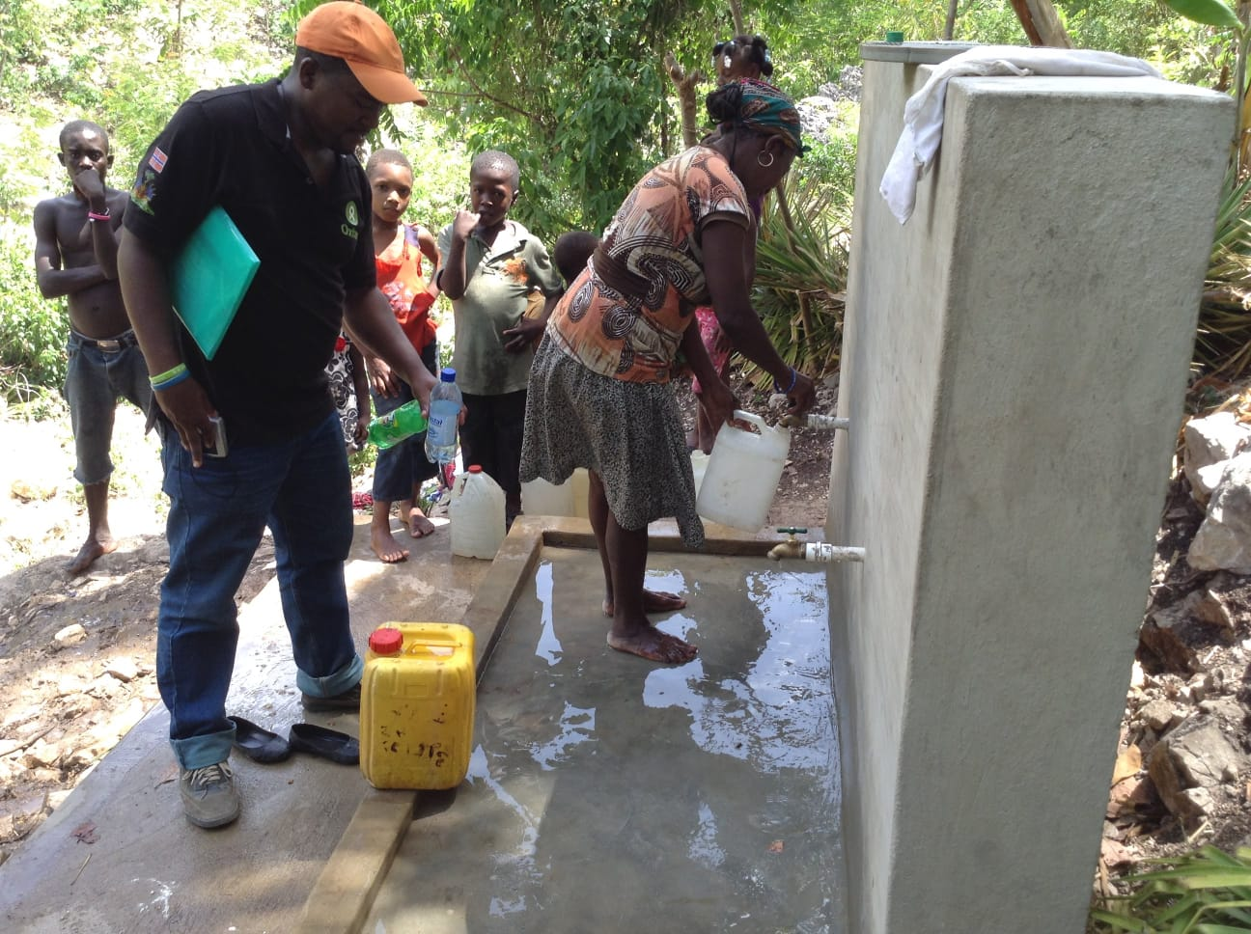
Notes:
Recap: we saw where risks sit and who holds power.
Use one diagnostic now; choose a realistic lever.
This sets up the case activity and links to Module 3 on power & justice.

Slide 76
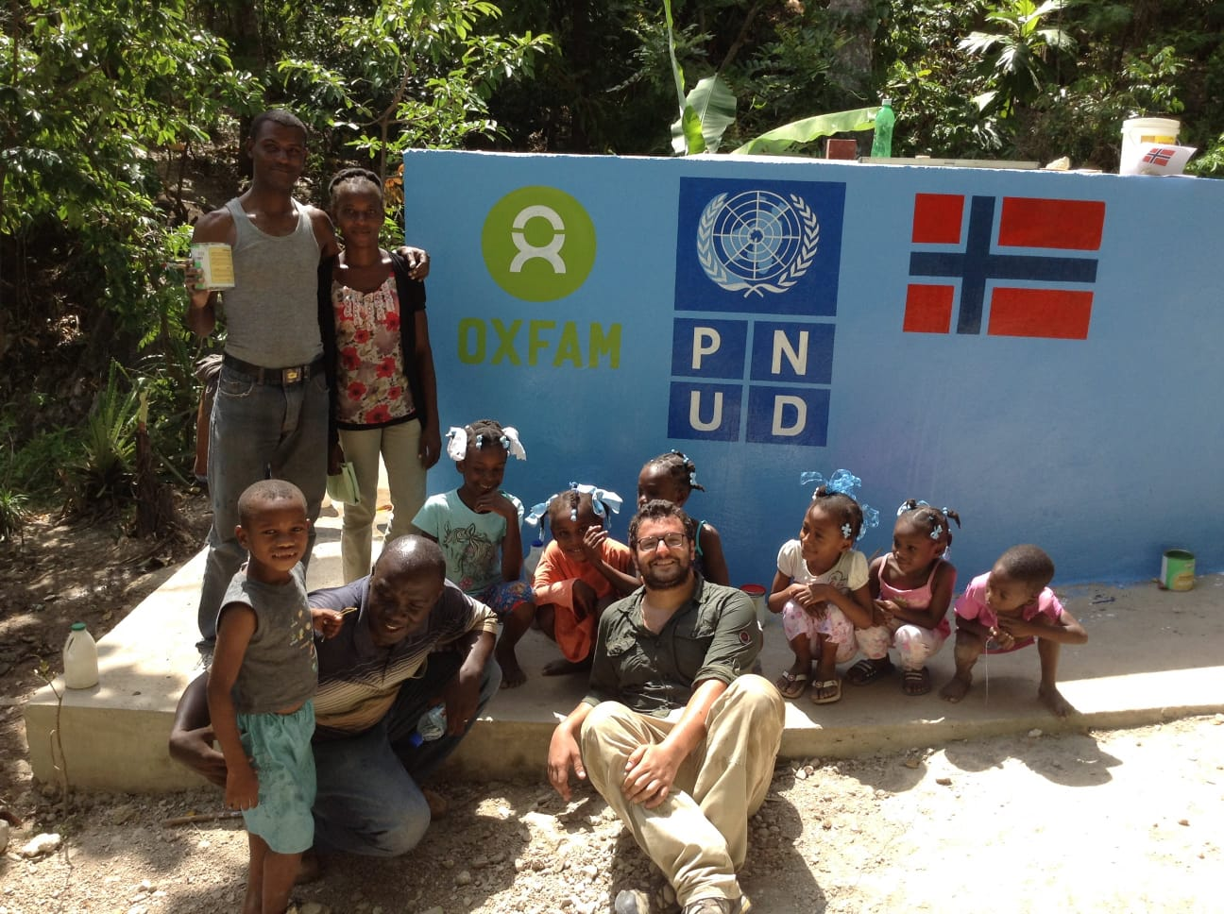
Notes:
Recap: we saw where risks sit and who holds power.
Use one diagnostic now; choose a realistic lever.
This sets up the case activity and links to Module 3 on power & justice.

Slide 77
Your task next
1. Build a stakeholder map (alignment × influence; proximity)
2. Mark allies, swing, blockers; flag essential and killers
3. Propose some engagement moves + mitigations (when possible)
Keep labels short; justify in one sentence each
Notes:
Recap: we saw where risks sit and who holds power.
Use one diagnostic now; choose a realistic lever.
This sets up the case activity and links to Module 3 on power & justice.

Slide 78
HIGH INFLUENCE
Gangs 🔴 + : near ⭐ ⚠️
Smallholders 🟢 +++ : near ⭐
OPPOSE
SUPPORT
Legend (use emojis/short codes next to each actor):
Alignment: 🟢 ally | 🟡 swing/unclear | 🔴 blocker
Influence: + (low) | ++ (mid) | +++ (high)
Proximity: near | mid | far
Special flags: ⭐ essential | ⚠️ killer assumption
LOW INFLUENCE

Slide 79
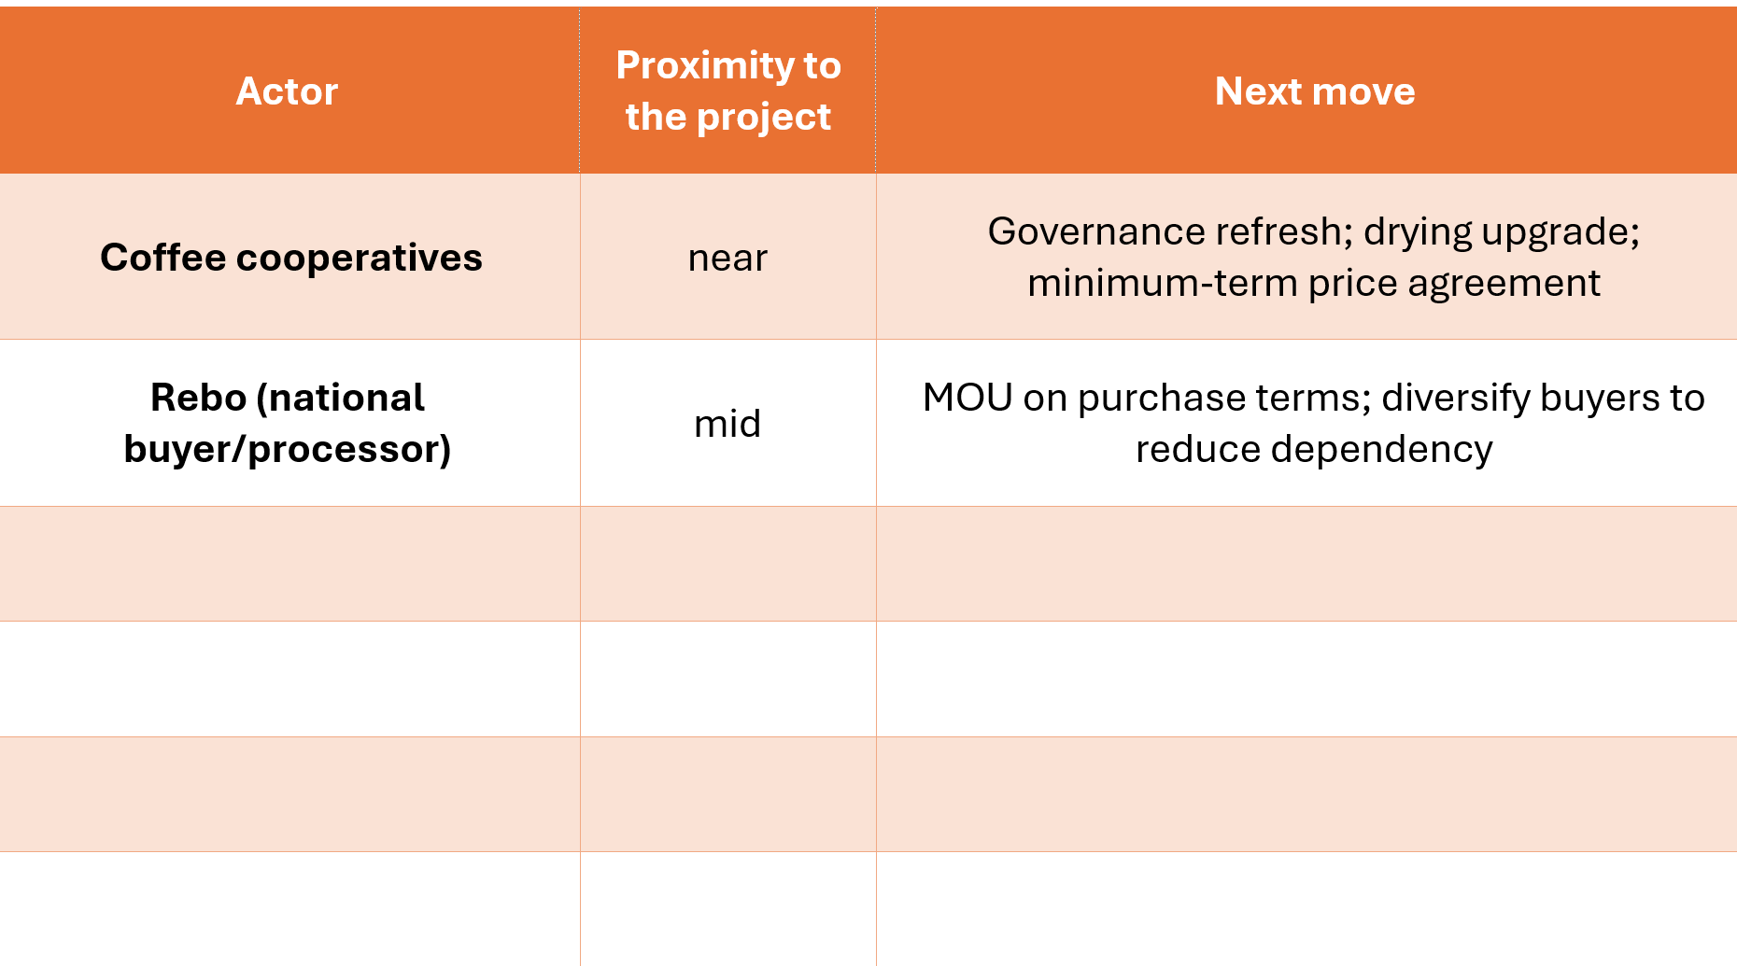

Slide 80
List observed problems (from the case).
Pick 1–2 priority problems → these will become your Specific Objectives (SO1–SO2).
Draft a simple logical framework (1 page).
  OG (fixed): Household food sovereignty.
  SO (1–2): from your problem selection.
  Results (2–3): what you will deliver to reach each SO.
  Activities: 2 activities per Result (short, concrete).
  NB: Strengths and weaknesses are internal to the project,
  while opportunities and threats are external factors that do not depend on the project.
Budget = €500,000; Direct beneficiary households = 400
Notes:
Recap: we saw where risks sit and who holds power.
Use one diagnostic now; choose a realistic lever.
This sets up the case activity and links to Module 3 on power & justice.

Slide 81
General Objective (fixed)
OG — Household food sovereignty.
Producer households in Les Cayes exercise greater autonomy over their diets—the right and real ability to choose healthy, culturally appropriate food—through stronger decision power, diversified on-farm food production, and fairer market terms.
Specific Objectives (elaborate 1 new SO or pick 1 or 2)
SO1 — Income for food choice.
Coffee income is more stable and higher, expanding households’ budget freedom to choose food (and reduce distress purchases).
SO2 — Agroecological diversification for self-provisioning.
Jardin Créole plots are enriched with staple and nutrient-dense foods (roots, legumes, fruit) while maintaining coffee, using agroecological techniques (shade, soil/water care, intercropping) and cooperative mutual aid (shared nurseries, collective labor, joint buying/selling) to withstand predatory market pressures and stabilize household food access and sovereignty.
SO3 — Fair terms & voice in the chain.
Smallholders (via coops) secure fair purchase terms and gain voice in decisions that shape the local coffee market (quality, timing, payments).
SO4 — Civic & financial inclusion for agency.
Producers obtain legal ID and safe credit, unlocking services and strengthening bargaining power beyond middlemen.
SO5 — Resilience that protects food access.
Farms and communities are better shielded from shocks (hurricanes, disease, corridor insecurity), so food access and incomes are less frequently disrupted.

